Slide 1
5th Online Meeting CoP 1
“Study tour Programme and Visa Check”
22 November 2019 10:00 – 12:00 GMT

Slide 2
Online Meeting Etiquette and Rules
General
Meeting will be recorded for documentation purposes
Check your Microphone and Camera is functioning
Mute Microphone if you do not have the floor to reduce background noise
Disable video if internet connection is weak
Chat Function within GO-TO Meeting
Send a message in the chat if there is point you wish to raise while members have the floor
GIZ Focal Point and Facilitator Tandem will respond to any questions raised in chat
GIZ Focal Point will assist with any Technical issues you may have (Message in chat or on Whatsapp

Slide 3
Agenda
Welcome and Introductions (5 min)
Visa Check with Members (20 min)
Presentation of Study tour Programme (20 min)
ASPYEE Registrations Status (10 min)
Closing Remarks and Questions (5 min)

Slide 4
What is the status of your visa application?
Submitted to the embassy?
Who has already recieved their Visa?
Difficulties that need to be addressed?
Who should help?

Slide 5
Study Tour Draft Programme
The final Programme will be circulated next week.
Every has been made to ensure that the programme of the study tour addresses the needs of the CoP,
We are confident that the programme will be interesting and exciting for the CoP!

Slide 6
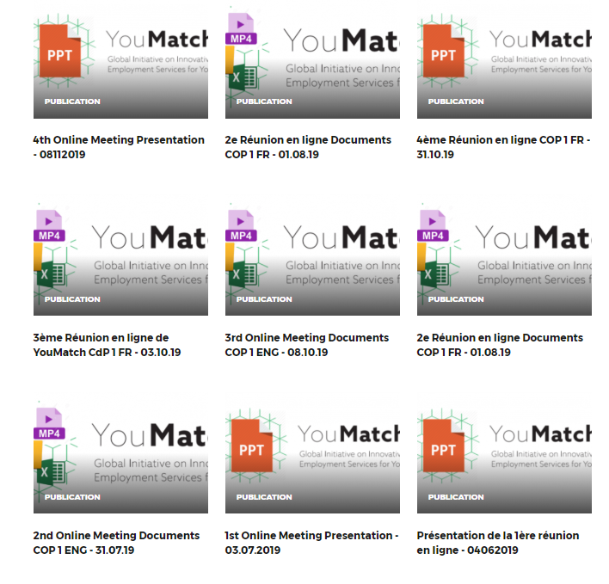
ASPYEE Statut d'enregistrement
Members Registered | External Experts
Mai | O. Diop
Zubeidy | Castel-Branco
Ephrem
Mike
Albius
Pachalo
Marcel
Indongo

Slide 7
Thank you all! Seen you soon in Germany

