Slide 1
YouMatch Communities of Practice on AUDA – NEPAD
ASPYEE Platform And Member Registeration

Slide 2
So…What is it?
The African Skills Portal For Youth Employment and Entrepreneurship
A continental knowledge sharing platform targeted at TVET, Skills, Employment practitioners and Policy Makers
Key knowledge platform for the Skills Initiative for Africa programme at AUDA-NEPAD
YouMatch has a role in fostering knowledge exchange on the platform

Slide 3
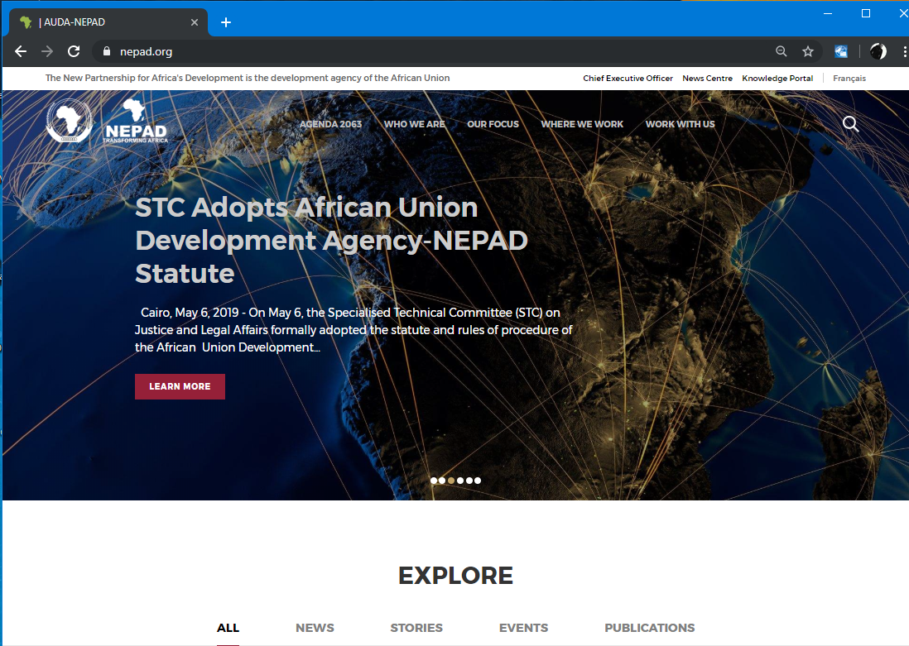
How does YouMatch fit in?
ASPYEE provides a space for CoPs in closed groups for exchanges
Allows CoPs access to added functionality on the portal:
- Forum for CoP discussions
- Access to Publications and the platform to develop publications for CoP thematic areas
- Blogs, news, events
- Avenue to access and exchange with Experts on CoP topics
AUDA-NEPAD will host YM CoPs on their Web Platform
Under the ASPYEE Portal
To gain access, Members of the YM network need to register into the CoP facility on the ASPYEE portal

Slide 4
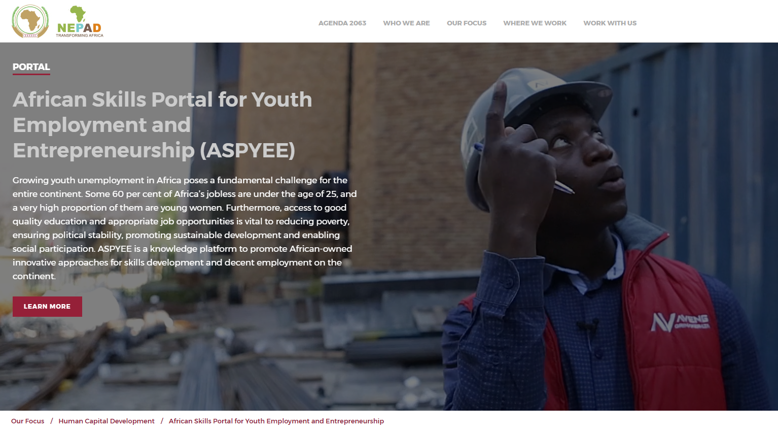
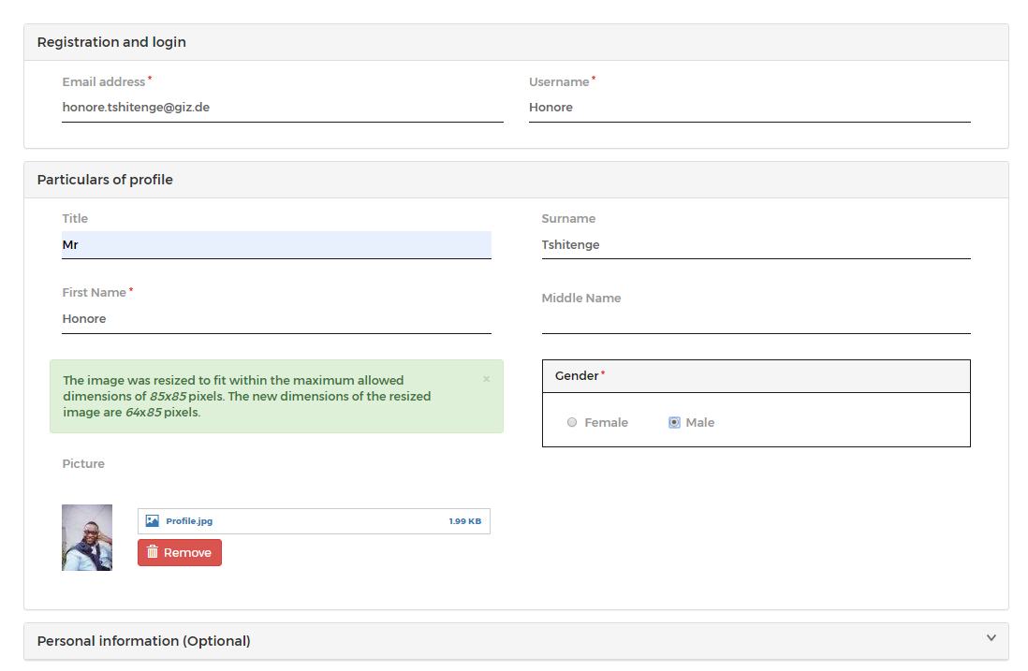
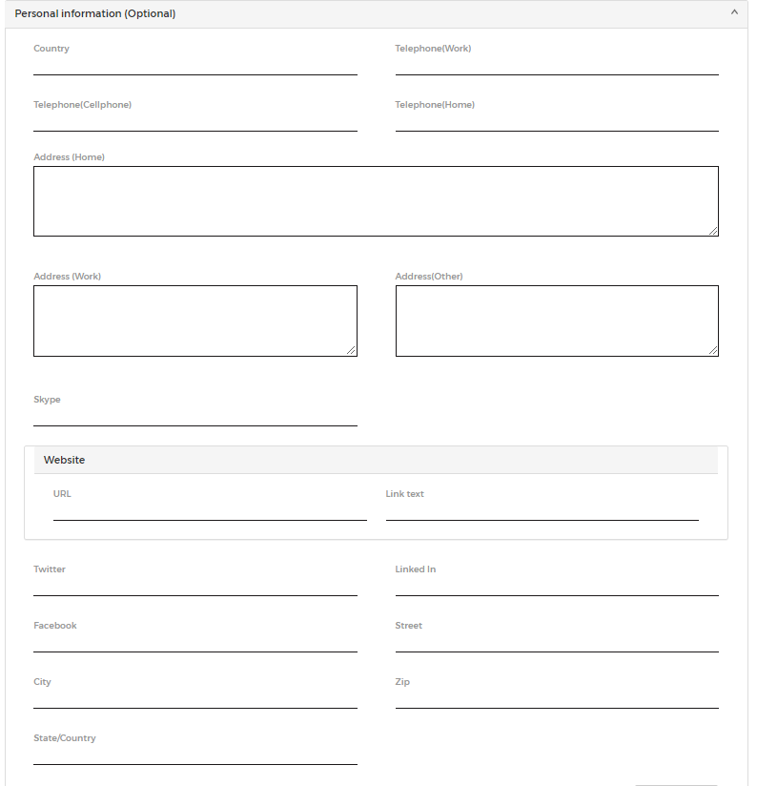
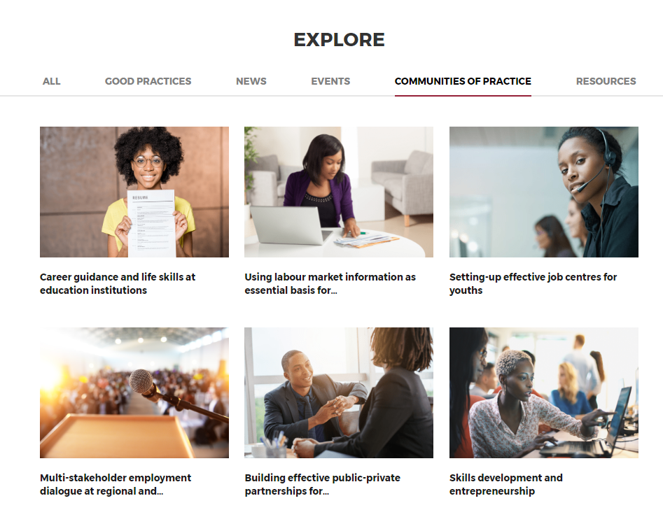
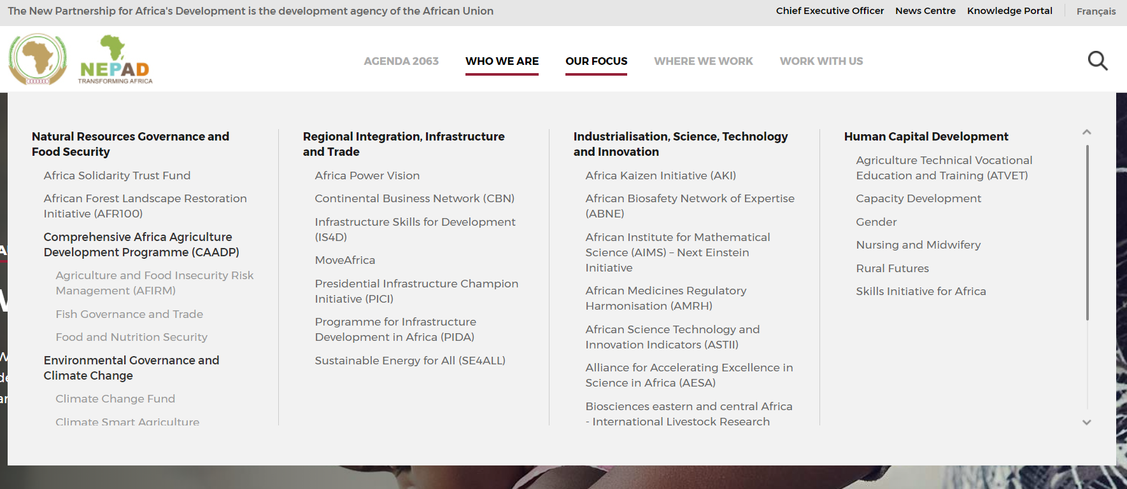
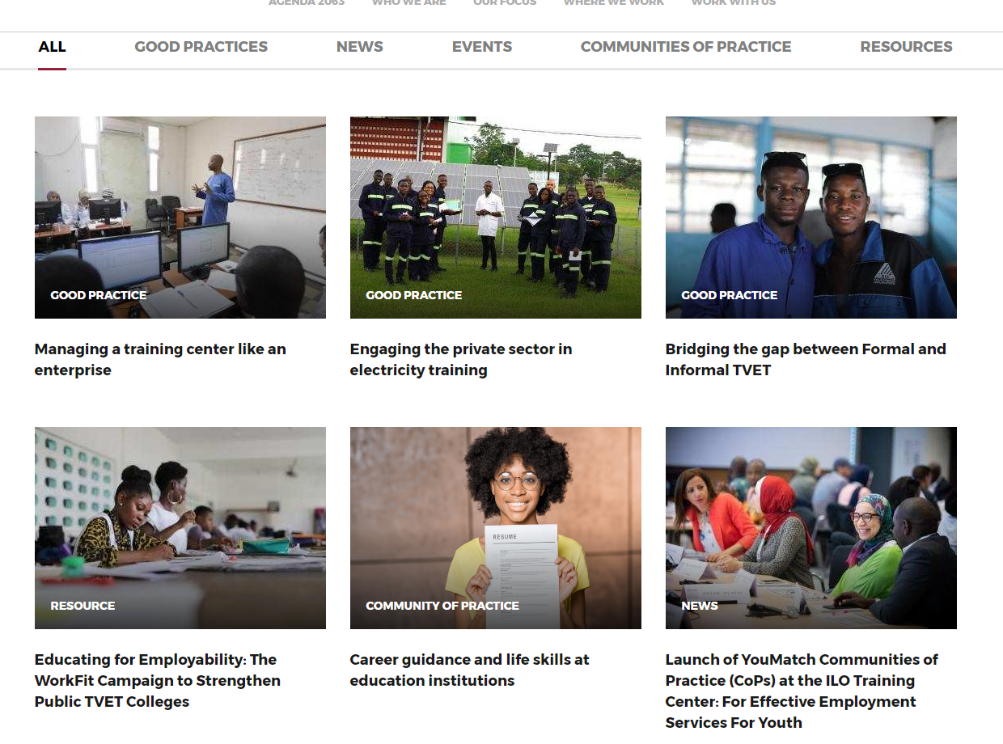
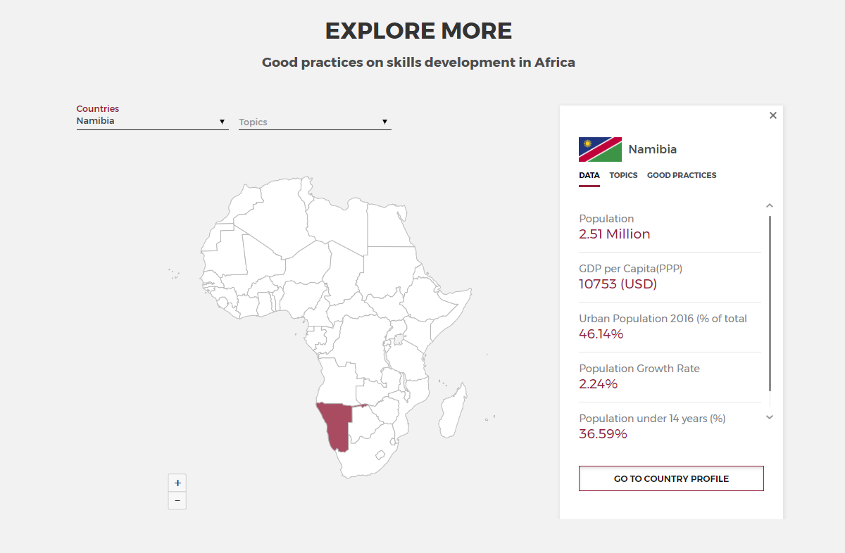
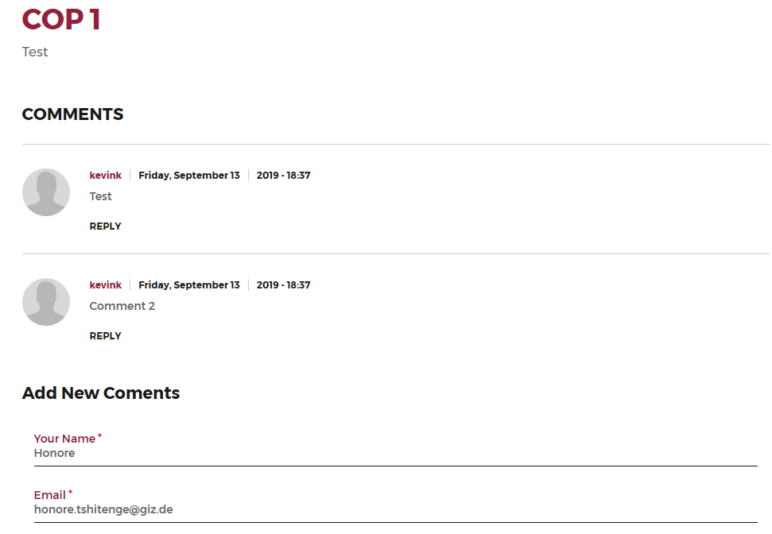
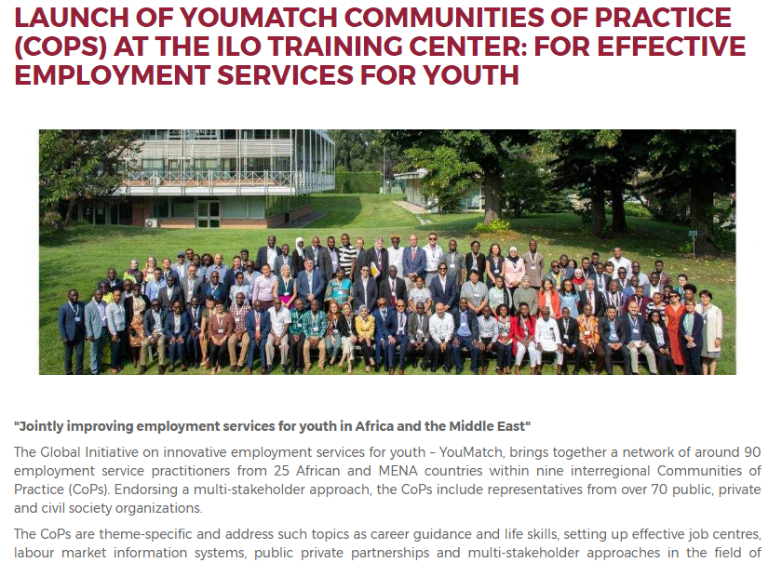
Welcome to ASPYEE
STEP 1
Enter the Web URL in your Web Browser https://www.nepad.org/who-we-are/about-us
Navigate to the “Our Focus” Tab and under Human Capital Development select the Skills Initiative for Africa
STEP 4
Once the CAPTCHA is entered and “create account” selected, an email will be sent to the CoP Moderator to accept your registration as an authenticated user.
Now registered as a verified user in the CoP, this gives access to CoP resources, allows you to interact member forums, follow news related to CoPs, publications, view media and provides the platform for the dissemination of CoP activities, products, upcoming meetings and sentiments.
STEP 3
On the registration page, fill out your basic information (Additional personal information will be helpful, but is not required to complete registration)
Personal information is not needed for registration and is optional. This information will
assist AUDA-NEPAD in understanding the needs and interested of its stakeholders and build a repository of experts. Fill this out should you wish to be included in such a database.
STEP 2
Locate your Community of Practice in the CoP Tab of the Portal
Once selected in the CoP overview landing page, select Register to begin the process of registration
Have a look around for some interesting news, good practices and in-depth country profiles from across the continent
Registration
Sign-up is easy and straightforward
Similar to creating an online account on other platforms and services

Slide 5
Next Steps
Your Facilitator and Focal point will contact you to inform you that you may begin to register. (2nd week of October/31st October)
Familiarize yourself with the portal!
Look out for more info in the portal from time to time

Slide 6
NB
Please note that due to the organizational changes in mandate and personnel. AUDA-NEPAD will revamp the user interface of the portal significantly.
It will change in looks, but the functionality will remain the same for our CoPs
Thank you!

