Slide 1
Third Online Meeting CoP 1 ENG
Using labour market information as essential basis for effective ES for youths
Yasameen Al-Nadheri
01.10.2019 / 12:00 am ( GMT)

Slide 2
Agenda for today
Welcome & Recall of technical hints (microphone, mute/unmute, internal chat…) 10 Minutes
Recap on Turin training. 10 Minutes
Action plan and activities 40 Minutes
Understanding ASPYEE online Platform 10 Minutes
Discussions “ Clarify the next steps” 40 Minutes
Short Checkout and Closure 10 Minutes

Slide 3
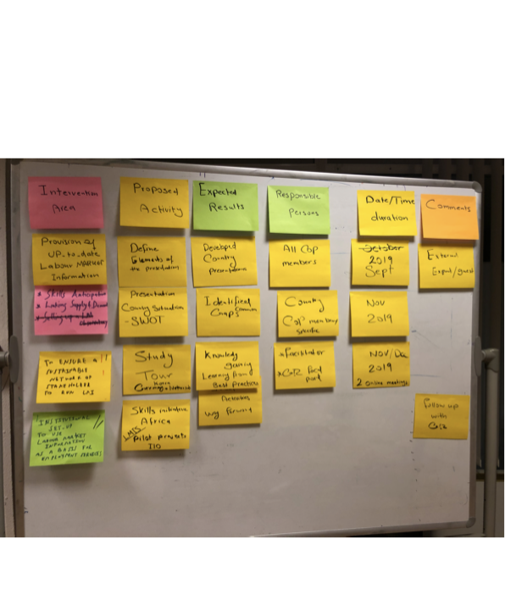
Recap on Turin Meeting - 29th of August 2019 1st Draft for our Action Plan

Slide 4
Action Plan for CoP (1) LMIS English
Intervention Area | Proposal Activity | Expected Results | Responsible Person | Date/Time Duration | Comments
Provision of Up- to-date Labour Market Information | Define elements of the presentation | Developed Country presentations | All CoPs Members | Sept 2019 | External Expert /Guest
- Skills Anticipation - Linking Supply & Demand | Presentation Country situation -SWOT | Identified Common Gaps | Country CoP members ( specific) | Nov 2019
To ensure sustainable network of Stakeholder to run LMIS | Study Tour Korea/ Netherlands/ Germany | Knowledge gaining Learning from Best Practices | Facilitator & GIZ Focal Point | Nov/Dec 2019 ( 2 online Meetings)
Institutional Set-up to use LMIS as a basis for employment Services | Skills initiative Africa by ILO LMIS-Pilot Project | Activities Way forward

Slide 5
Introduction to CoP (1) Action Plan ( 2019/2020)
Block 1
LMI Governance and Institutional Arrangement
Block 2
Skills Anticipation (Tools and Methodology)
Block 3
AUC and AUDA COP Participation / Transversal

Slide 6
Introduction to CoP (1) Action Plan ( 2019/2020)
 | BLOCK 1
 | LMI Governance and Institutional Arrangement
No. | Proposed Activity | Expected Results | Responsible person(s) | Expected Date |  |  |  |  |  | Comments
 |  |  |  | Sep | Oct | Nov | Dec | Jan | Feb
1 | Online Meeting To prepare study tour and | Identification of elements and expectations of Study Tour | GIZ TM, Facilitator, Members |  | End Week 21-28 Oct | x

Slide 7
 | BLOCK 1
 | LMI Governance and Institutional Arrangement
No. | Proposed Activity | Expected Results | Responsible person(s) | Expected Date |  |  |  |  |  | Comments
 |  |  |  | Sep | Oct | Nov | Dec | Jan | Feb
2 | Study Tour on LMI Governance and Institutional arrangement | Deepening of common understanding of LMI and actors | GIZ YM |  |  |  | 1st Week 2-6 Dec |  |  | Proposed countries for Study Tour: Europe (to be defined) African Union Commission may be invite to join Study tour will be done with other language LMI CoP 3 day programme 2 days site visit 1 day brainstorming/strategizing

Slide 8
No. | Proposed Activity | Expected Results | Responsible person(s) | Expected Date |  |  |  |  |  | Comments
 |  |  |  | Sep | Oct | Nov | Dec | Jan | Feb
3 | Mapping of LMI approaches in various countries (member countries) Exchange of experience on LMI governance among members | Country presentations and mapping of LMI in each context Strengthen group understanding of LMI in from each member state Exchanges on good Practice | YM members |  |  |  | x | x |  | Define and develop elements of presentations and mapping exercise, this can be agreed upon and defined during the study tour Experts may be invited to comment on the presentations

Slide 9
 | BLOCK 1
 | LMI Governance and Institutional Arrangement
No. | Poposed Activity | Expected Results | Responsible person(s) | Expected Date |  |  |  |  |  | Comments
 |  |  |  | Sep | Oct | Nov | Dec | Jan | Feb
4 | Webinar exchanges with experts on the topics of LMI governance to highlight a multi dimensional approach. | Expansion of the groups views in the field of LMI | GIZ, ETF, Members |  |  |  |  |  | x | ETF experts will be made available
5 | Drafting of Recommendations on LMI Governance | CoP contributes to a new or exisiting Policy document, Recommendation at the regional level | GIZ YM, Members |  |  |  |  |  |  | The AUC through Mr Oumar Diop would give further direction and orientation.

Slide 10
 | BLOCK 2
 | Skills Anticipation (Tools and Methodology)
No. | Proposed Activity | Expected Results | Responsible person(s) | Expected Date |  |  |  |  |  | Comments
 |  |  |  | Sep | Oct | Nov | Dec | Jan | Feb
1 | Online meeting to exchange experience and best practices | Understanding each members position on Skills anticipation in their respective countries Identification of transferable and replicable best practices from each country | Members

Slide 11
 | BLOCK 2
 | Skills Anticipation (Tools and Methodology)
No. | Proposed Activity | Expected Results | Responsible person(s) | Expected Date |  |  |  |  |  | Comments
 |  |  |  | Sep | Oct | Nov | Dec | Jan | Feb
2 | Webinar with external expert to learn about international best practices | Broadening CoPs understanding of skills anticipation in the international context and possibly identify ways transferable approaches to Skills anticipation | GIZ YM , ETF

Slide 12
 | BLOCK 2
 | Skills Anticipation (Tools and Methodology)
No. | Proposed Activity | Expected Results | Responsible person(s) | Expected Date |  |  |  |  |  | Comments
 |  |  |  | Sep | Oct | Nov | Dec | Jan | Feb
3 | Exchange face to face / series of webinar (TBD) |  | GIZ YM |  |  |  |  |  |  | This study tour, face to face activity will be more clearly defined through the process of mapping the contexts of Skill Anticipation in each member state and through the provision of international best practices.
4 | Drafting of policy recommendations on skills anticipation |  | Members

Slide 13
BLOCK 3
 | AUC and AUDA COP Participation / Transversal
No. | Proposed Activity | Expected Results | Responsible person(s) | Expected Date |  |  |  |  |  | Comments
 |  |  |  | Sep | Oct | Nov | Dec | Jan | Feb
1 | Online Exchange with AUC to give direction on work and recommendations | Clear outline on Joint Product (policy recommendation) that the CoPs will be asked to contribute to, or develop. | GIZ YM, AUC |  |  |  |  |  |  | This is to allow the AUC to give orientation to the groups aspects of learning and make provisions for to contribute to the 2016 LMI proposal

Slide 14
 | AUC and AUDA COP Participation / Transversal
No. | Proposed Activity | Expected Results | Responsible person(s) | Expected Date |  |  |  |  |  | Comments
 |  |  |  | Sep | Oct | Nov | Dec | Jan | Feb
2 | Online Exchange with ILO on LMI (within the framework of SIFA implementation) | Identify synergies of ILO and SIFA proposed activities CoP members can participate in. | GIZ YM |  |  |  |  |  |  | ILO and SIFA plan to implement LMI in a number of countries. As well as the implementation, further capacity development measures will be undertaken. CoP members may be able to participate in these capacity development measures in line with the ILO and SIFA plan of action. The SIFA focus on this regard is strongly on LMI and its institutional arrangement and involves elements of peer learning and mapping exercises

Slide 15
Confirming availability for Study Tour beginning of Dec
First week of Dec 2019
Yes /No ?

Slide 16
ASPYEE Platform And Member Registration
By GIZ Focal Point
Honore Tshitenge

Slide 17
Discussions “ Clarify the next steps”
Date for next online
meeting

Slide 18
Any other questions?

Slide 19
Check - out
Please formulate 1 sentence or even a word /person: about the meeting of today

Slide 20
Thank you !
Bye bye

