Slide 1


COP 6: Building effective public-private partnerships for ES
Facilitator: Itumeleng Mphure
Tandem: Lillian Moremi
Focal Point: Lisa Walter
Welcome to the first COP meeting: 26 June 2019

Slide 2

Navigation Hints
Recording
Using of camera / difference camera and screen share
Using slides during the Meeting
Presentations
Managing participants’ interventions
Support for the session: the Tandem and the GIZ focal point

Slide 3

AGENDA
1. Welcome and navigation hints: 5mins
Agenda for today
Meeting objectives and expected results
2. Personal presentation: 25 mins
3. Getting to know the program: 30 mins
Presentation of the YouMatch program
Discussion & clarification of the objectives of the COP.
4. Next steps: 20 mins
5. Closing & check out: 10mins

Slide 4

Meeting Objectives and Expected Results
COP Member introductions and getting to know more about the YouMatch Program
Clarification of meeting planning (preferred hours etc)
Next steps for second meeting (Turin Prep)

Slide 5


Personal Presentations

Slide 6

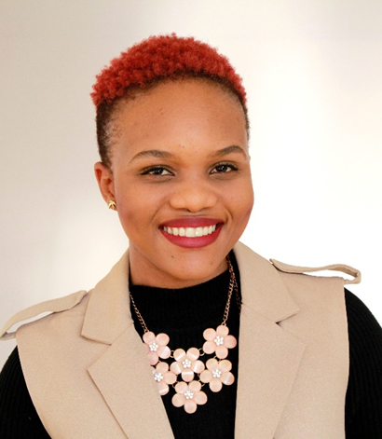
Country: South Africa
Designation: Program Officer
Organisation: South African Institute of International Affairs
Itumeleng Mphure

Slide 7

Siham Ayele
Country: Ethiopia
Designation: Project Manager
Organisation: Dejera.com

Slide 8
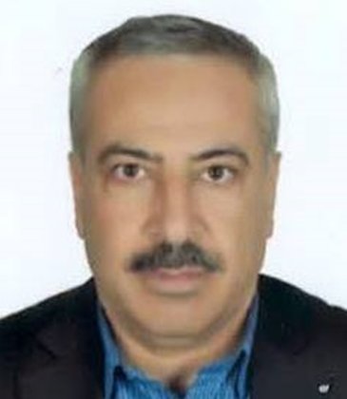
Country: Palestine
Designation: Head of Information Department
Oranisation: Federation of Palestinian Chambers of Commerce
Nazieh Mardawi

Slide 9
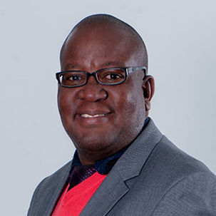
Dr Fernando Siamisang
Country: Botswana
Designation: Director of Human Resource Development Planning (Demand)
Organisation: Human Resource Development Council (HRDC)

Slide 10
Iqbal Alrawashdeh
Country: Jordan
Designation: Administrative staff
Organisation: Development and Quality Assurance center, Al Balqa Applied University

Slide 11
Yousri M. Ahdoush
Country: Palestine
Designation: Head of Local Employment Section
Organisation: Ministry of labour (Ramallah, Palestinian Territories)

Slide 12
Matsena Mokono
Country: South Africa
Designation:
Organisation: Department of Labour, South Africa

Slide 13
Joseph Jonah Akpan
Country: Nigeria
Designation:Employment and Wages Department
Organisation: Ministry of Labour and Employment, Nigeria

Slide 14
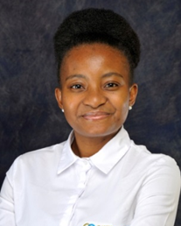
Country: Botswana
Designation: Learning and development professional
Organisation: Career Coaching
Lillian Moremi

Slide 15

Lisa Walter
Country: Germany
Designation: Focal Point
Organisation: GIZ

Slide 16
Getting to know the program
Facilitator Introduction
GIZ focal point presentation
Duration: 30 minutes

Slide 17
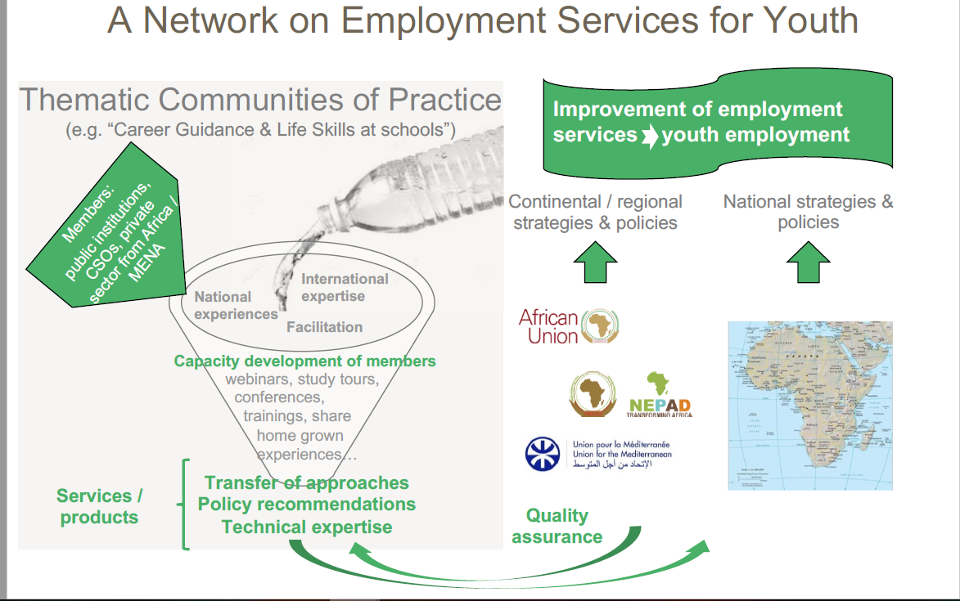

Slide 18
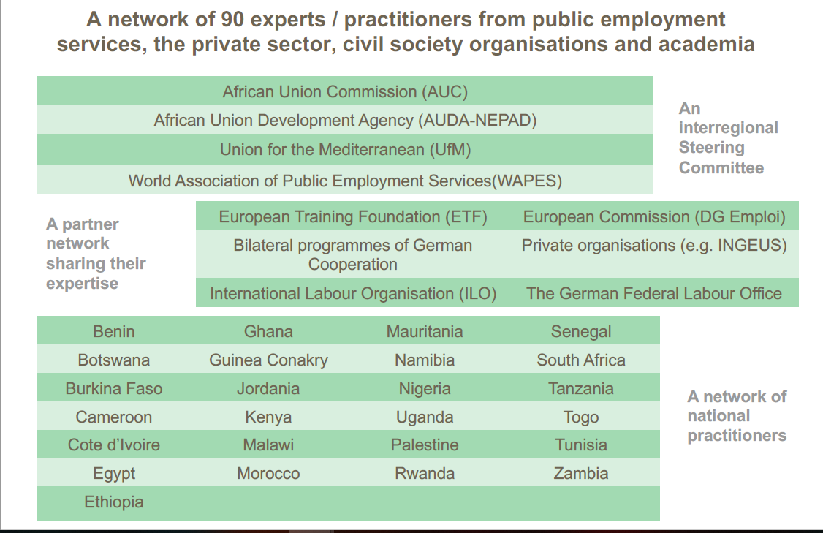

Slide 19
Next steps
Questionnaire on knowledge map
Next online meeting
Reminder to register on ILO online
Questions and Comments
Profiles

Slide 20

Check out:
How do you feel after this first meeting?

