Slide 1
First online Meeting
3rd July 2019
Community of Practice (1):
“Labour Market Information Systems as an Essential basis for effective Employment Services for Youth"

Slide 2
WELCOME
Jordan / Ethiopia / Italy / Palestine / Namibia / Malawi / Rwanda / Uganda / Germany

Slide 3
Navigation Hints
Recording
Using of camera and screen share
Using slides during the Meeting
Presentations
Managing participants’ interventions
Mute and unmute yourself
Put your video on and off
Write chat message to a specific person/ to all
Support for the session: the Tandem and the GIZ focal point

Slide 4
AGENDA
Welcome and navigation hints (5 mins)
Agenda for today
Meeting objectives and expected results
Personal presentation (25 mins)
Getting to know the program (30 mins)
Presentation of the YouMatch program
Discussion & clarification of the objectives of the CoP
Next Steps (20 mins)
Closing & check-out (10mins)

Slide 5
Meeting Objectives and Expected Results
CoP members get to know each other and the program YouMatch
Clarification of meeting planning (preferred hours etc)
Next steps for the second meeting (preparation for Turin

Slide 6
Community of Practice (1)
1 Facilitator
1 Tandem
1 YouMatch Focal Point
10 Members
6 public
3 private
2 GIZ

Slide 7
Personal Presentations

Slide 8
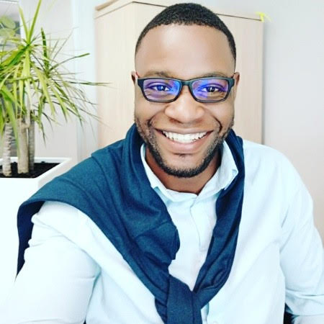
Name: Honore Tshitenge
Organization: GIZ
Position: Project Advisor – YouMatch Focal Point for CoP (1)
Country: South Africa

Slide 9
Name: Yasameen Al-Nadheri
Organization: YouMatch,GIZ
Position: Facilitator for CoP (1) ,YouMatch Tandem for CoP (3)
Country: Yemen- Based in Jordan

Slide 10
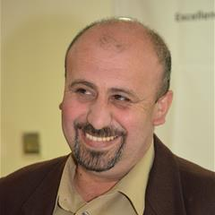
Name: zubeidy Al zubeidy
Organization: GIZ
Position: programme advisor
Country: Palestine

Slide 11
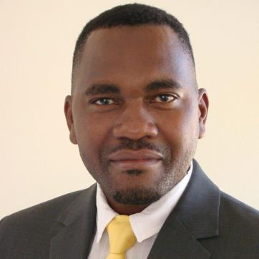
Name: Indongo Indongo
Organization: Namibia Training Authority
Position: Manager -Research and Policy Planning
Country: Namibia Training Authority

Slide 12
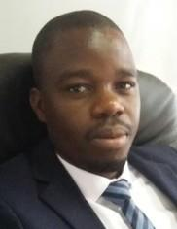
Name: Pachalo Mwanza
Organization: Planning and Research Division for TEVET Authority
Position: Monitoring and Evaluation Specialist
Country: Malawi

Slide 13
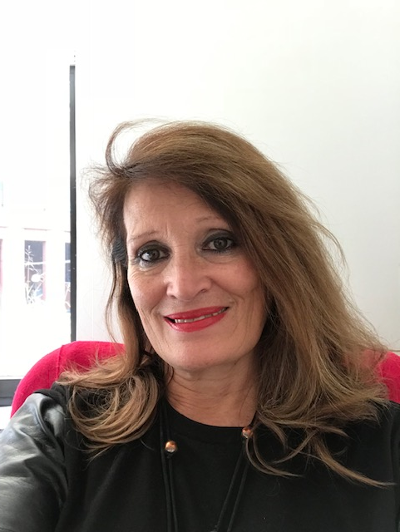
Name: Eduarda Castel-Branco
Organization: European Training Foundation
Position: Senior Specialist in VET Policies and Systems Operations Department
Country: Italy

Slide 14
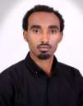
Name: Ephrem Gidey Berhe
Organization: Addis Ababa Science and Technology University
Position: Assistant Professor of Industrial Engineering
Country: Ethiopia

Slide 15
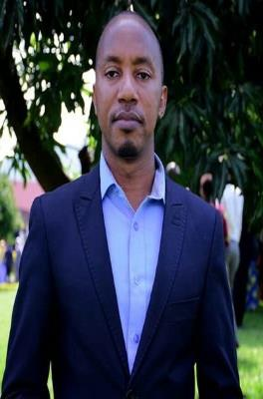
Name: AGABA Gilbert
Organization: Rwanda Development Board-RDB
Position: Labour Market Analyst-RDB
Country: Rwanda

Slide 16
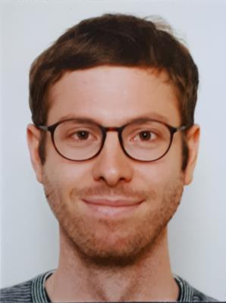
Name:Marcel Hertel
Organization: GIZ
Position:Advisor for Labour Market Statistics and especially Labour Market Information Systems
Country: Germany- Based in Rwanda

Slide 17
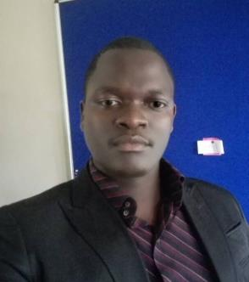
Name :MIKE GEORGE MTUKULO
Organization: Ministry of Labour, Youth, Sports and Manpower Development
Position: Labour Officer
Country: Malawi

Slide 18
About YouMatch II
Facilitator: Introduction
GIZ focal point (presentation)
Discussion
Duration: 30 minutes

Slide 19
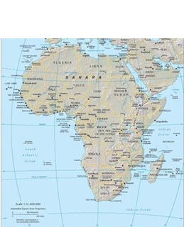
A Network on Employment Services for Youth
Thematic Communities of Practice
(e.g. “Career Guidance & Life Skills at schools”)
Improvement of employment services youth employment
Members:
public institutions, CSOs, private sector from Africa / MENA
Continental / regional strategies & policies
National strategies & policies
International expertise
National experiences
Facilitation
Capacity development of members
webinars, study tours,
conferences,
trainings, share
home grown
experiences…
Services / products
Transfer of approaches
Policy recommendations
Technical expertise
Quality assurance

Slide 20
A network of 90 experts / practitioners from public employment services, the private sector, civil society organisations and academia
African Union Commission (AUC)
African Union Development Agency (AUDA-NEPAD)
Union for the Mediterranean (UfM)
World Association of Public Employment Services(WAPES)
An interregional Steering Committee
A partner network sharing their expertise
European Training Foundation (ETF) | European Commission (DG Emploi)
Bilateral programmes of German Cooperation | Private organisations (e.g. INGEUS)
International Labour Organisation (ILO) | The German Federal Labour Office
Benin | Ghana | Mauritania | Senegal
Botswana | Guinea Conakry | Namibia | South Africa
Burkina Faso | Jordania | Nigeria | Tanzania
Cameroon | Kenya | Uganda | Togo
Cote d’Ivoire | Malawi | Palestine | Tunisia
Egypt | Morocco | Rwanda | Zambia
Ethiopia
A network of national practitioners

Slide 21
Next Steps
Questionnaire on knowledge map
Next online meeting- best time of the day, time zone etc
Reminder to register on ILO online
Questions and Comments

Slide 22
Next Steps
Following documents via mail after meeting;
YouMatch ppt
Profiles of all CoP members in one PDF file

Slide 23
Check Out
What motivated me today for my future participation ( e.g. regarding the group, the information shared…)?

Slide 24
THANK YOU!!

