Slide 1
First online CoP Meeting
25th June 2019
Community of Practice 2
“Career Guidance & Life Skills at Schools, Universities, etc.”

Slide 2
WELCOME
Namibia / South Africa / Ethiopia / Jordan / Kenya / Rwanda / Uganda / Palestine/ Tanzania / Germany

Slide 3
Navigation Hints
Housekeeping for Facilitation online;
Recording
Using of camera and screen share
Using slides during the Meeting
Presentations
Managing participants’ interventions
Mute and unmute yourself
Put your video on and off
Write chat message to a specific person/ to all
Support for the session: the Tandem and the GIZ focal point

Slide 4
AGENDA CoP 2 First Online Meeting June 25, 8:00-9:30 AM CEST
Welcome and navigation hints (5 mins)
Agenda for today
Meeting objectives and expected results
Personal presentation (25 mins)
Getting to know the program (30 mins)
Presentation of the YouMatch program
Discussion & clarification of the objectives of the CoP
Next Steps (20 mins)
Closing & check-out (10mins)

Slide 5
Meeting Objectives and Expected Results
CoP members get to know each other and the program YouMatch
Clarification of meeting planning (preferred hours etc)
Next steps for the second meeting (preparation for Turin conference)

Slide 6
Community of Practice 2
1 Facilitator
1 Tandem
1 YouMatch Focal Point
15 Members
7 public
1 private
5 civil society
1 Academia
1 GIZ

Slide 7
Personal Presentations
CoP Members Introduction Guide
Names
Organization/ company
Position
Country
Expectation
Something fun about yourself

Slide 8
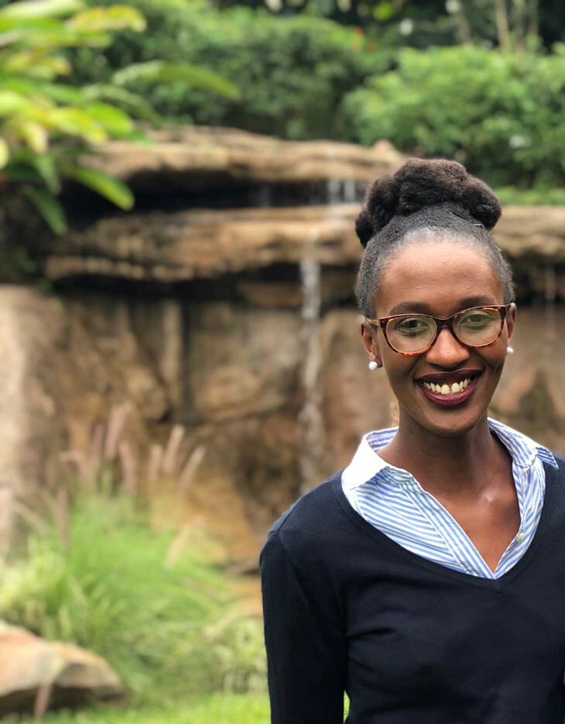
Ms. Happiness Uwase
Organisation: YouMatch & Bridge2Rwanda
Position: Facilitator
Country: Rwanda

Slide 9
Ms. Judith Guckenbiehl
Organisation: GIZ
Position: GIZ Focal Point
Country: Germany

Slide 10
Ms. Sharleen Muthoni
Organisation: YouMatch & EDUQUATOR
Position: Co-facilitator
Country: Kenya

Slide 11
Mr. Jean Claude Ndayambaje
Organisation: DOT (Digital Opportunity Trust)
Position: Youth Leadership Program Manager
Country: Rwanda

Slide 12
Ms. Vuyelwa Nqojane
Organisation: Department of Employment and Labour
Position: Assistant Director
Country: South African

Slide 13
Ms. Rabeah Al Haj Hassan
Organisation: GIZ Jordan_Employment Oriented Vocational Training for Skilled Crafts Sector
Position: Technical Advisor
Country: Jordan

Slide 14
Dr. Moh'd Suliman Abedlkarim Sha'ar
Organisation: Ministry of Education, Professional Services in the Department of Vocational Education
Position: Director
Country: Jordan

Slide 15
Ms. Dina Hammad
Organisation: Ministry of Labour
Position: Head of Employment & Career Guidance department
Country: Jordan

Slide 16
Mr. Nicolars Tembwe
Organisation: Valombola Vocational Training Center (EU HUB)
Position: Head of Training Support
Country: Namibia

Slide 17
Ms. Elivi Shinedima
Organisation: Ndjuluwa97 Academy
Position: Founder
Country: Namibia

Slide 18
Mr. Sebahudin Hussein Siraj
Organisation: Addis Ababa TVET Bureau
Position: Expert of industry extension technical skill development for micro and small enterprises and Deliverology
Country: Ethiopia

Slide 19
Prof. Charles Ondieki
Organisation: TVET CDACC (Curriculum Development Assessment and Certification Council)
Position: Chairman
Country: Kenya

Slide 20
Mr. Ndung’u Kahihu
Organisation: CAP Youth Empowerment Institute
Position: Executive Director
Country: Kenya

Slide 21
Mr. Emmanuel Mutuma
Organisation: BrighterMonday.com
Position: C.E.O
Country: Kenya

Slide 22
Ms. Kissa Vivian Kilindu
Organisation: TAESA
Position: Director
Country: Tanzania

Slide 23
Ms Grace Mukwaya
Organisation: Platform for Labour Action
Position: Executive Director
Country: Uganda

Slide 24
Ms. Juliana Zanayed
Organisation: PYALARA
Position: Program Manager
Country: Palestine

Slide 25
Mr. Rafi Daraghmah
Organisation: Al-Najah University
Position: Director of Employment and Graduate Affairs Unit
Country: Palestine

Slide 26
About YouMatch II
Facilitator: Introduction
GIZ focal point (presentation)
Discussion
Duration: 30 minutes

Slide 27
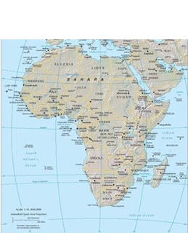
A Network on Employment Services for Youth
Thematic Communities of Practice
(e.g. “Career Guidance & Life Skills at schools”)
Improvement of employment services youth employment
Members:
public institutions, CSOs, private sector from Africa / MENA
Continental / regional strategies & policies
National strategies & policies
International expertise
National experiences
Facilitation
Capacity development of members
webinars, study tours,
conferences,
trainings, share
home grown
experiences…
Services / products
Transfer of approaches
Policy recommendations
Technical expertise
Quality assurance

Slide 28
A network of 90 experts / practitioners from public employment services, the private sector, civil society organisations and academia
African Union Commission (AUC)
African Union Development Agency (AUDA-NEPAD)
Union for the Mediterranean (UfM)
World Association of Public Employment Services(WAPES)
An interregional Steering Committee
A partner network sharing their expertise
European Training Foundation (ETF) | European Commission (DG Emploi)
Bilateral programmes of German Cooperation | Private organisations (e.g. INGEUS)
International Labour Organisation (ILO) | The German Federal Labour Office
Benin | Ghana | Mauritania | Senegal
Botswana | Guinea Conakry | Namibia | South Africa
Burkina Faso | Jordania | Nigeria | Tanzania
Cameroon | Kenya | Uganda | Togo
Cote d’Ivoire | Malawi | Palestine | Tunisia
Egypt | Morocco | Rwanda | Zambia
Ethiopia
A network of national practitioners

Slide 29
Next Steps
Questionnaire on knowledge map
Next online meeting before Turin- best time of the day, time zone etc
ILO Survey- https://www.surveymonkey.com/r/?sm=NQA2KXA_2BrerdsFh3kMXVfQ_3D_3D
Reminder to register on ILO online
Questions and Comments

Slide 30
Next Steps
Following documents via mail after meeting;
YouMatch ppt
Profiles of all CoP members in one PDF file

Slide 31
Check Out
What motivated me today for my future participation ( e.g. regarding the group, the information shared…)?

Slide 32
THANK YOU!!

