Slide 1
CoP 2: Career Guidance and Life Skills in Schools
Facilitator:
Happiness Uwase & Sharleen Muthoni
Third Online Meeting
Date: October 16, 2019
Venue: GotoMeeting

Slide 2
Agenda for Today
Welcome remarks by facilitator, repeat navigation hints, and Agenda of the day (5 min)
Recap of Turin Conference (15 min)
Finalization of Action Plan (45 min)
Introduction to ASPYEEN platform by GIZ focal point (10 min)
Q&A (10 min)
Discussion on the next steps (15 min)
Check-out and Closure (10 min

Slide 3
Objectives
Finalise Action Plan
Introduction to ASPYEEN Platform
Concrete next steps.

Slide 4
Check In
Giv 1-2 things you learnt or remember from the Turin conference.

Slide 5
Value Proposition
The CoP on career guidance and life skills supports career guidance providers and decision makers who seek to improve career guidance and life skills provision for youth by the way of practical networking and peer exchange which can help to identify/develop best practice approaches and policy to better guide learners, job seekers and youth in our communities.

Slide 6
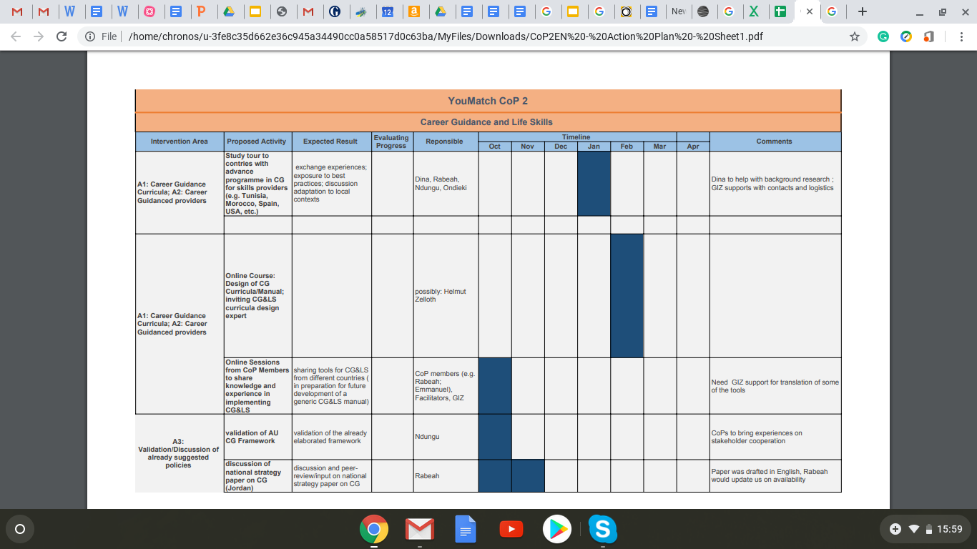
Summary Of Action Plan in Turin

Slide 7
Finalise Action Plan
Be precise with what we want to do as a CoP
Clear roles, responsibilities, and timelines
Concrete next steps-..... Moving forward

Slide 8
YouMatch Communities of Practice on AUDA – NEPAD
ASPYEE Platform And Member Registeration

Slide 9
So…What is it?
The African Skills Portal For Youth Employment and Entrepreneurship
A continental knowledge sharing platform targeted at TVET, Skills, Employment practitioners and Policy Makers
Key knowledge platform for the Skills Initiative for Africa programme at AUDA-NEPAD
YouMatch has a role in fostering knowledge exchange on the platform

Slide 10
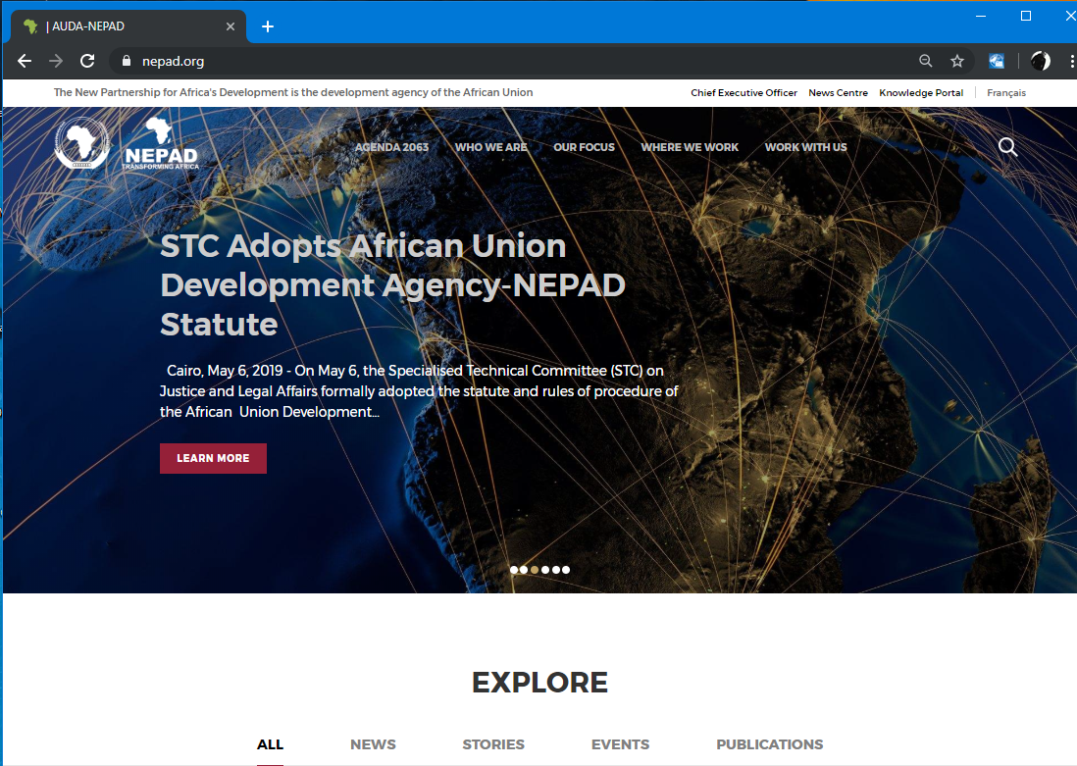
How does YouMatch fit in?
AUDA-NEPAD will host YM CoPs on their Web Platform
Under the ASPYEE Portal

Slide 11
ASPYEE provides a space for CoPs in closed groups for exchanges
Allows CoPs access to added functionality on the portal:
- Forum for CoP discussions
- Access to Publications and the platform to develop publications for CoP thematic areas
- Blogs, news, events
- Avenue to access and exchange with Experts on CoP topics
To gain access, Members of the YM network need to register into the CoP facility on the ASPYEE portal

Slide 12
Registration
Sign-up is easy and straightforward
Similar to creating an online account on other platforms and services

Slide 14
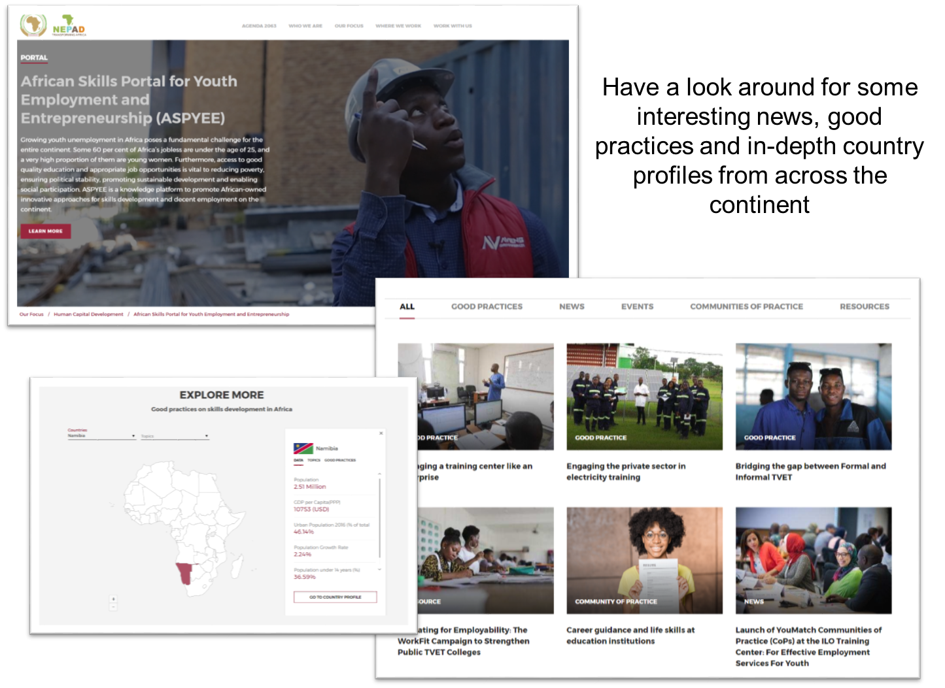

Slide 16
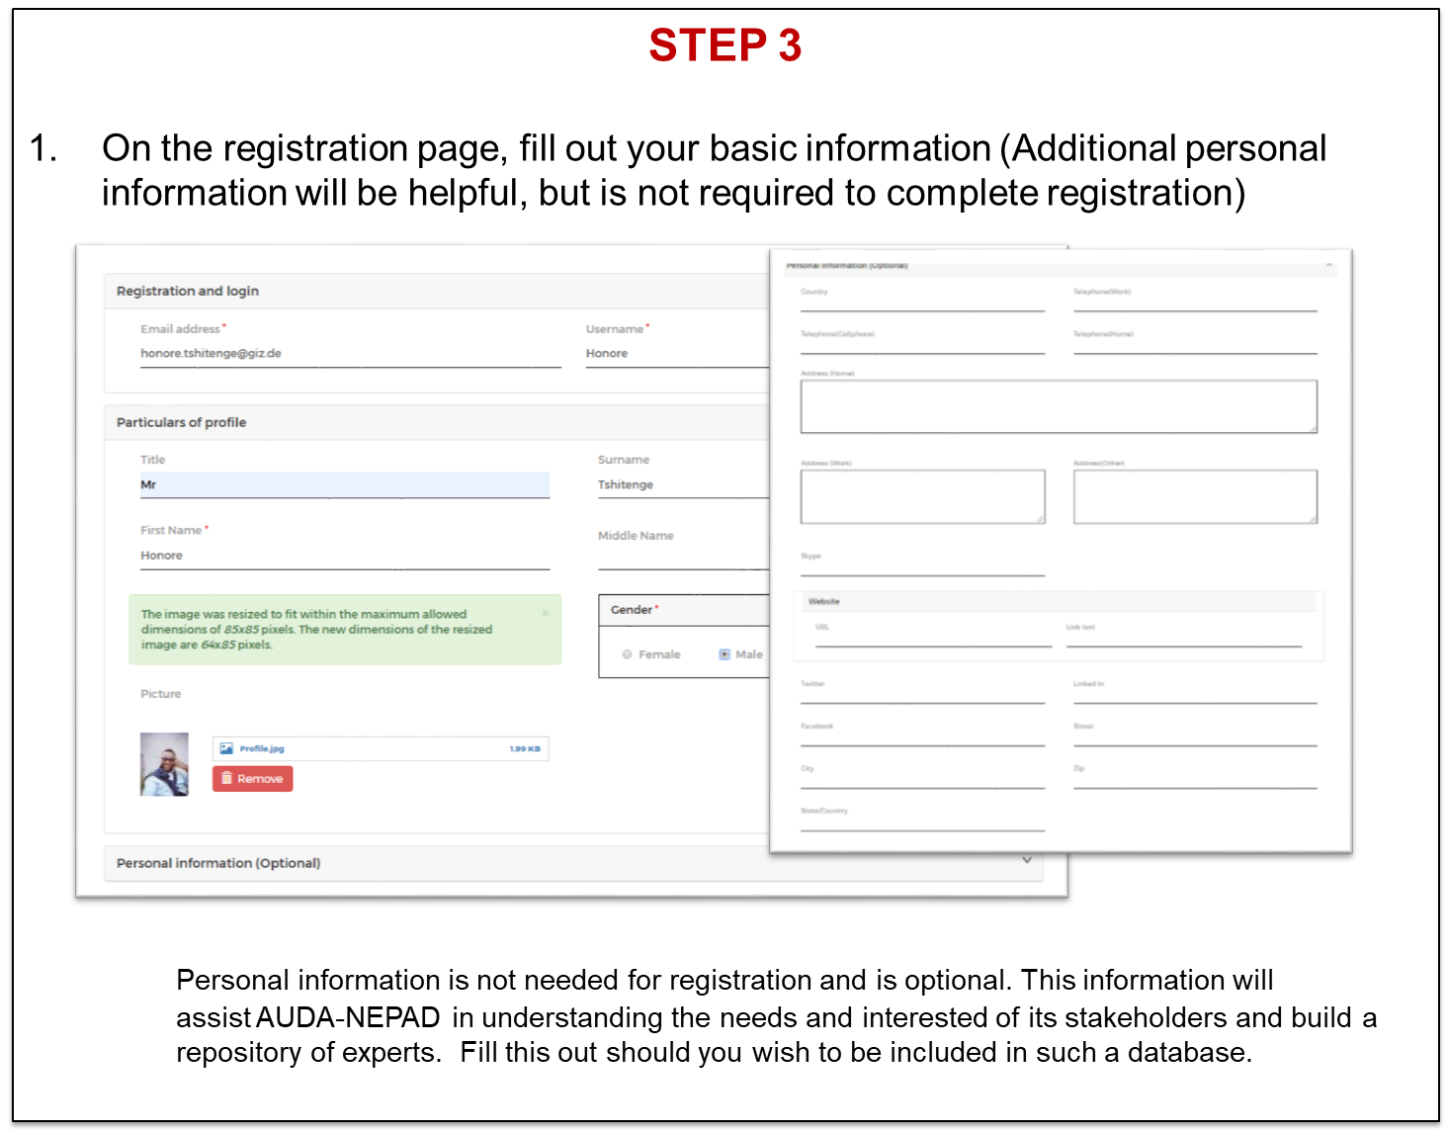

Slide 18
Next Steps
Your Facilitator and Focal point will contact you to inform you that you may begin to register. (at the end of the month)
Familiarize yourself with the portal!
Look out for more info in the portal from time to time

Slide 19
NB
Please note that due to the organizational changes in mandate and personnel. AUDA-NEPAD will revamp the user interface of the portal significantly.
It will change in looks, but the functionality will remain the same for our CoPs
Thank you!

Slide 20
Q&A
https://www.nepad.org/skillsportalforyouth

Slide 21
Discussion on Next steps
Discuss responsibilities and next steps for next activity
Topic of next online Meeting
Date for next online meeting

Slide 22
Check out
What do you think we have achieved today and what can we change in our next meeting?

Slide 23
THANK YOU!

