Slide 1
4th Online CoP Meeting
“Using labour market information as essential basis for effective Employment Services for youths”
08 October 2019 : 11:00 – 01:00 GMT

Slide 2
Online Meeting Etiquette and Rules
General
Meeting will be recorded for documentation purposes
Check your Microphone and Camera is functioning
Mute Microphone if you do not have the floor to reduce background noise
Disable video if internet connection is weak
Chat Function within GO-TO Meeting
Send a message in the chat if there is point you wish to raise while members have the floor
GIZ Focal Point and Facilitator Tandem will respond to any questions raised in chat
GIZ Focal Point will assist with any Technical issues you may have (Message in chat or on Whatsapp

Slide 3
AGENDA
Time | Programme
11:00 – 11:10 (10 mints) | Welcome and navigation hints Agenda for today
11:10 – 11:20 (10 mints) | Introduction round of our guest Mr. Oumar Diop and CoP members.
11:20 – 12:00 (40 mins) | Presentation by Mr. Oumar Diop Questions
12:00 – 12:40 (40 mins) | Study Tour – Potential Institutions
12:40 – 12:45 (5 mins) | Registration for Study Tour – Who hasn’t registered yet? Progress in visa app
12:45 – 12:55 (10 mints) | Brief Overview of ASPYEE
12:55- 13:00 (5 mints) | Short check-out and Closure

Slide 4
Mr. Oumar Diop
AUC - Labour , Employment and Social Affairs
Coordinator, AUC-ILO-IOM-ECA Joint Programme on Labour Migration Governance for development and Integration
Master in Business Law, University of Dakar
Graduate of National Civil Service School of Senegal, Competition and Trade Commissioner
Master of Business Administration, HEC Montreal
Director of Employment, Senegal, 1996-2006
Senior Policy Officer, Labour and Employment, AUC, 2007-2016
Adviser to Commissioner for Social Affairs, 2016-2018

Slide 5
African Labor Market Information System
Harmonization and Coordination Framework for LMIS
Department of Social Affairs,
Commission of the African Union
Presentation by: Mr Oumar Diop (AUC)
08 November 2019 : YouMatch LMIS CoP

Slide 6
FRAMEWORK FOR HARMONIZATION AND COORDINATION OF LMIS IN AFRICA
Main challenges:
Vocational Training (TVET) and Labor Market Needs
Informal economy and rural labor market
Social Protection and Productivity
Low capacity for monitoring and evaluating employment policies
Low regional integration of labor market vs
Mobility and Migration of the inter and intra-regional workforce
Women and Youth

Slide 7
Goal: To have a harmonized Conceptual and Methodological Framework to improve the formulation of employment policies in Africa, their monitoring and evaluation;
Goals:
Define a set of key indicators on employment and work that are relevant to the follow-up of the Ouagadougou 2015 Action Plan and Agenda 2963 (2023 targets on employment, labor and social protection)
Facilitate the harmonization, coordination and consistency of the collection, processing, analysis and dissemination of employment and work data at all levels;
Ensure regular production of harmonized statistics on work and employment as defined above
Promote knowledge and accessibility by all to reliable and up-to-date data on employment and work
Strengthen the technical and institutional capacity of countries

Slide 8
LMIS Harmonization and Coordination Framework Approach
Work with common Definitions, Concepts and Terminologies in harmony with international standards
2. 4 Categories of Labor Market and Poverty Indicators
a. Work, social protection and employment
b. Productivity and competitiveness
c. Poverty and labor market
d. Governance (types of LMI, methodologies, periodicity, organization / structure, funding, LMI analysis, etc.)
3. Each country conducts an audit of the LMIS, establishes a SIMT Coordination Unit on the basis of the social dialogue, and provides funding

Slide 9
Towards an integrated LMIS: Modelling for Demand Driven on Labor Market Information Systems (LMIS)
LMIS Type 1 is a database comprising of public actors and generating only data. As it does not contain any services or tools, it brings little added value to end users (employers or employees).
LMIS Type 2 is an intermediate LMIS with public actors but has also produced, which offers services, creators of value for the end user (such as job search services).
LMIS Type 3 is an advanced LMIS with characteristics similar to Type 1, but whose ability to generate value is such that private actors become effective participating entities to the extent that they find an economic benefit to be made part of the system.

Slide 10
Towards an integrated LMIS: Modelling for Demand Driven on Labor Market Information Systems (LMIS)
Current situation:
Observatories of employment and education in several countries, often with tripartite governance
Labor statistics directorates / units or similar structures for collecting, analyzing and disseminating labor market information.
The general observation is that they are more of the LMIS Type 1. This explains their limited contribution to the efficiency and effectiveness of the functioning of the labor market.

Slide 11
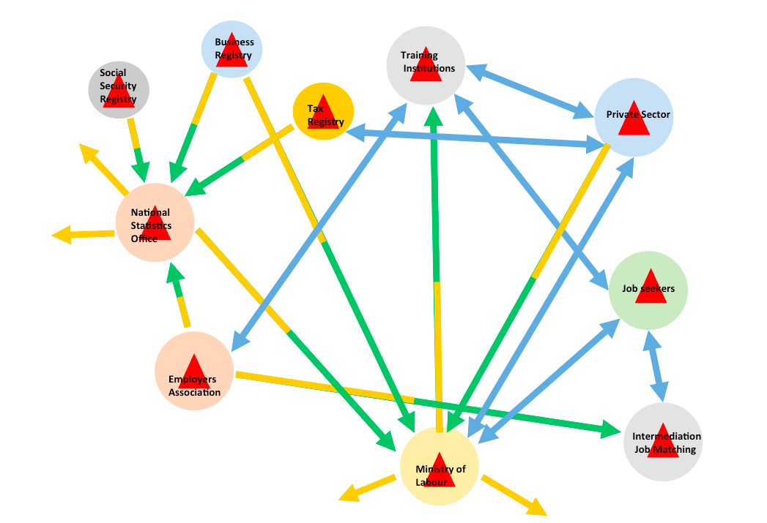
LMIS RECOMMENDATION FOR AFRICAN STATES
Member States are encouraged to build a type 3 LMIS.
A Type 3 LMIS includes several public and private actors and provides several services. The private sector contributes to the formation of labor market information and maintains close links with the public entities of the system
Notes:
committed to free movement by 2015, free trade area by 2017; establishment of an economic and monetary union by 2028; access to electricity for over 70% of the African population by 2040; halving the flow of illicit capital by 2023 , 100% literacy by 2063, increasing life expectancy to 75 years

Slide 12
THANK YOU!
Your Recommendations are Welcome

Slide 13
STUDY TOUR PREPARTION
…in line with findings of “Roadmap for Development of LMIS in Africa”, functions of CoP members and the CoP Action Plan
Core Topics have been identified:
Roles and responsibilities of different actors at national and regional level for collection, analysis and dissemination of labour market information (overview and insights from different perspectives)
Variety of sources for LMI, including qualitative data, private sector intermediation services and big data (e.g. job search sites)
Relevance of LMI for economic development planning as well as education and labour market policies / measures
Engagement of private sector in LMI (for data collection, analysis and usage)
Usage of LMI in design and implementation of different labour market intervention and services (including career guidance)
User-friendly processing and visualisation of LMI
Addressing informal sector in LMI

Slide 14
YouMatch has Identifed
10
Institutions that can address the core topics of interest to our COP that is possible to visit during the study tour.

Slide 15
Potential Institutions
Institution | Relevant scope of work
Federal Employment Agency | As part of official statistics in Germany, the Federal Employment Agency compiles and publishes labor market statistics for all regions. The labor market statistics give the institutions and politics directly involved in the labor market a secure basis for assessing the overall situation and regional developments, so that action needs can be identified in good time and measures can be planned. Employees and employers are provided with guidance in career and economic decisions. The statistics provide the basic data for labor market research, they complement the statistics of the Federal Statistical Office and the statistical offices of the Länder and they are an important source for the work of the local statistical authorities.
Potential Topics | Collection, analysis and dissemination of LM at national and regional level Cooperation with other actors Policy advice Variety of LMI sources Visualisation of LMI Design of LM services Digital LMI tools Usage of labour market information for career guidance

Slide 16
Institution | Relevant scope of work
Institute for Employment Research / Federal Employment Agency | Institute for Employment Research (IAB) conducts research on the labour market in order to advise political actors at all levels. Economists, sociologists and researchers from other social science and methodological disciplines create the base for empirically well-informed labour market policy by way of excellently linked research Different tools and survey methods, including the “Establishment Panel”, “Job Vacancy Survey”
Potential Topics | Roles and Responsibilities Sources for LMI Relevance for policy making Digital LMI tools

Slide 17
Institution | Relevant scope of work
Institute for Employment Research / Federal Employment Agency | Design, preparation and analysis of regional research surveys; regional impact research on labour market instruments; cooperation with the Regional Directorate of the Federal Employment Agency and with local employment offices; advice for local labour market policy actors.
Potential Topics | Cooperation patterns at regional level Regional survey methods and tools

Slide 18
Institution | Relevant scope of work
Skilled workers monitor „Perform“ | Topic: What is the specific situation of skilled workers in the individual academic and professionally qualified professions in the regions?
Potential Topics | Private sector participation in LM Cooperation in LMI Digital visualisation of LMI Roles and responsibilities
Institution | Relevant scope of work
Occupational Information Centre in North Rhine Westphalia / Hesse | (Self-help) Info point for all citizens on topics related to education, work and the job market
Potential Topics | Usage of labour market information for career guidance Digital LMI tools

Slide 19
Institution | Relevant scope of work
Association for innovative employment promotion North Rhine Westphalia | As part of labor market monitoring, data from official statistics on the labor and training market as well as employment and corporate development in NRW are processed, analyzed and published in practice-oriented reports. They serve as the basis of a sound labor market and employment policy. The publication series G.I.B. Short reports provide compact information on selected topics of the employment and training market in North Rhine-Westphalia. Semiannual reports on the labor market situation in NRW show the most important labor market developments in North Rhine-Westphalia. The presentation is done for the level of the 16 labor market regions as well as for the level of districts and independent cities in NRW. Annual report on the transition from school to work: this report looks at the ways in which school leavers leave lower secondary education and the achievements of young people in vocational schools. The analysis is based on data from integrated training reporting and municipal training monitoring and is presented in a differentiated way according to municipalities.
Potential Topics | LMI at regional level Usage in regional policies and measures Processing and visualisation

Slide 20
Institution | Relevant scope of work
IWAK University of Frankfurt | The IWAK is a practice-oriented research institute of the Goethe University Frankfurt am Main with a focus on regional labor markets and qualification. It supports decision-makers from politics, associations, administration and companies in optimizing the functioning of regional and municipal labor markets as well as in improving qualification. The IWAK provides necessary information as well as scientific advice, monitoring and evaluation. Tools / Projects: IAB Establishment Panel Hessen Big Data Projects for Labour Market Actors (with Wollybi Germany) Regional job forecasts (regio pro): Information about future regional labor needs in Hesse and their use in practice European Network on Regional Labour Market Monitoring (EN RLMM)
Potential Topics | LMI at regional level Policy advisory Variety of LMI sources EN RLMM: Access to experiences of RLMM in other European countries (potential contribution of other members by Skype); plus summary of findings on informal employment (Annual Meeting in October)

Slide 21
Institution | Relevant scope of work
Regional Employment and Occupational Forecasts for Hesse | Since 2010, regio pro has been providing medium-term forecasts of employment and career development across Hesse, its administrative districts and districts, as well as county-level cities. The forecasts are updated every two years and the forecast horizon is extended by two years. Currently, regio pro provides forecasts by professional degrees, occupational groups and economic sectors until 2024. Interactive information platform: results of the forecasts by 2024 in a regional comparison; past and probable employment development in individual occupations, requirement levels, qualifications or economic sectors in the Hessian districts, independent cities and government districts. regio pro is a project of the Institute for Economics, Labor and Culture (IWAK). Regio pro receives funding from the Hessian Ministry for Economic Affairs, Energy, Transport and Housing and the European Union - European Social Fund.
Potential Topics | LMI at regional level Cooperation among actors Policy advice Visualisation of LMI

Slide 22
Institution | Relevant scope of work
Federal Institute for Vocational Education and Training | BIBB conducts its own surveys in addition to processing external data. This provides the basis for evaluations and analyses, which then are included in publications such as the annual Data Report. Topics: Employment Surveys; Transition to VET; Vocational education and training and decent employment (survey regarding apprenticeship wages, employment statistics and surveys amongst the working population
Potential Topics | LMI with linkage to education / VET policies and measures
Institution | Relevant scope of work
German Council of Economic Experts | The Council of Economic Experts for the Review of Macroeconomic Development is a body of economic policy advice, to present a periodic appraisal of the overall economic development of the Federal Republic of Germany from an independent expert's point of view, thereby contributing to facilitating the formation of judgments by all bodies responsible for economic policy and the public. Products: Annual reports, occasional and special reports
Potential Topics | Policy advice Collaboration between actors

Slide 23
Registration for the YouMatch study tour to Germany from 2-6 December 2019
Who hasn’t registered yet?
Project Team YouMatch Germany 2019
germany2019@youmatch.greenstorming.de
Progress in Visa Application

Slide 24
Brief on ASPYEE

Slide 25
Evaluation
Motivation for future participation, one phrase.

Slide 26
Thank you all! See you in Germany

