Slide 1
Rwanda Labour Market Information System (LMIS)

Slide 2
Outline
What is LMIS?
Why LMIS?
Importance of LMIS for Rwanda
Achievements of LMIS

Slide 3
Objectives of Rwanda LMIS
Identify information and data gaps on labour market
Work with different stakeholders to ensure collection and availability of LMI.
Analyze LMI in Rwanda
Provide guidance to different stakeholders to make evidence based decisions in Labour Market:
Policy makers
Educators and students
Employers and investors
Forecast labour demand and supply for human resource planning

Slide 4
Current Data Source
Secondary Data
NISR
ORG/RDB
RSSB
WDA
RRA
ILO Website
Universities
Ministry of Education
Primary Data
RDB: Job portal & Skills Database
Surveys (Skills gap, Job creation, Employment intensity study,…)

Slide 8
Main Labour Market Indicators
Labour force indicator
Skills development indicators
Job creation indicators
Business development indicators formal sector
Employment indicators
Unemployment and labour underutilization

Slide 9
Analytical Products of LMIS
Traceability Study,
Employment and its projections,
Discussion paper on available and needed skills,
Social Demographic Report,
Skills gap reports (9 Sectors),
Employment Newsletter,
Employment of TVET Graduates,
Monthly job creation report
Quarterly job barometer brief
Labour Market brief on Immigration
Labour Market brief on Enterprise Development

Slide 10
Stakeholder Wheel
LMIS
Policy maker (Government)
Students, Graduates, Job seekers & Employees
Training providers
Public employers, Private employers, Foreign Investors
Employment Service Centers
Data providers (NISR, RSSB, RRA, ORG, …)

Slide 11
System demonstration
www.lmis.gov.rw

Slide 12
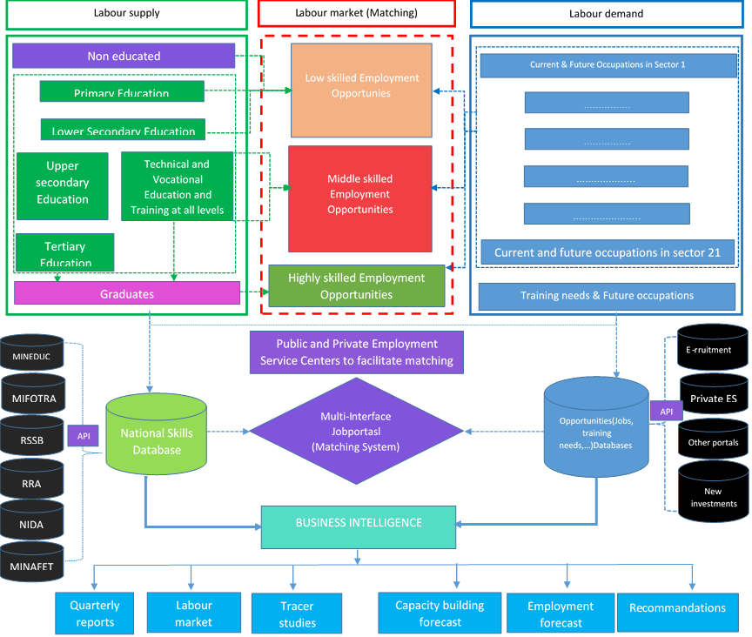

Slide 13
Rwanda Quarterly labour force survey: design and main results

Slide 14
Outlines
Introduction
Quarterly labour force survey design
Main results on quarterly LFS
QLFS release calendar
Conclusion

Slide 15
1. Introduction
The National Institute of Statistics of Rwanda introduced the labour force survey (LFS) program to provide key stakeholders, Ministry of Public Service and Labour and Ministry of Finance and Economic Planning, the Ministry of Education, International Labour Organization and other users, with needed labour statistics.
To monitor progress of different programs and policies such as national Strategy for transformation( NST1), Sustainable Development Goals (SDGs), Vision 2020 and vision 2050,relevant, reliable, coherent, timely and accessible labour statistics have to be produced.
Till 2015, most of labour statistics indicators were derived from EICV which is conducted on once in three years.
There was an unmet demand labor statistics
RLFS was introduced in 2016 using 2013 International standards on statistics of work, employment and underutilization
Rwanda labour force survey was initially designed as annual survey with the sample spread over two points in a year
The annual sample size is 18,688 households and it was 9,344 households for each bi-annual round since August 2016 till August 2018
Since 2016, in addition to pilots survey reports, 5 bi-annual reports and 2 annual report were published.
Since February 2019, the LFS was redesigned to produce quarterly estimates at National level.

Slide 16
Quarterly labour force survey design: Purposes
The purpose of labour force redesign:
Provide quarterly estimates of the main labour force indicators at the national level
To reduce the sample rotation scheme from four to three visits
To comply with IMF data dissemination standards (SDDS)
Maintain the total annual sample size at the same level

Slide 17
Quarterly labour force survey design

Slide 18
questionnaire design
SECTION A: HOUSEHOLD ROSTER
SECTION B.EDUCATION
SECTION C. IDENTIFICATION OF EMPLOYED, TIME-RELATED UNDEREMPLOYED, UNEMPLOYED, AND PERSONS IN POTENTIAL LABOUR FORCE
SECTIOND. CHARACTERISTICS OF MAIN EMPLOYMENT
SECTIONE. CHARACTERISTICS OF SECONDARY EMPOYMENT
SECTIONF. PAST EMPLOYMENT
SECTIONG. UN PAID HOME PRODUCTION OF GOODS AND SERVICES IN LAST 7 DAYS
H. CHARACTERISTICS OF SUBSISTENCE AGRICULTURE WORK LAST MONTH
SECTION I: HOUSING AND HOUSEHOLD ASSETS

Slide 19
Main results on quarterly LFS

Slide 20
Key concepts and definitions
Concept | Definition
Employment (Working for pay or profit) | E
Unemployment (Not employed, actively looking for job and available) | U
Out of Labour force (Not employed nor unemployed) | N
Working age population (Pop16+) | E+U+N
Labour force (LF) | LF = E+U
Potential labour force (Available not job seekers + job seekers not available) | P
Extended labour force (XLF) | XLF = E+U+P
Time-related underemployment | T
Labour force participation rate | LF/Pop16+
Employment-population ratio | E/Pop16+
Unemployment rate (LU1) | U/LF
Combined rate of unemployment and time-related underemployment (LU2) | (U+T)/LF
Combined rate of unemployment and potential labour force (LU3) | (U+P)/XLF
Composite measure of labour underutilization (LU4) | (U+T+P)/XLF

Slide 21
Summary labour force indicators, August 2019 (Q3):
Working age population 16 years old and over
7,181,532persons
Outside the labour force (Not employed nor unemployed) 3,427,678person |  |  |  | Labour force (The sum of employed and unemployed)
 |  |  |  | 3,753,854 persons
 |  |  |  | Labour force participation rate
 |  |  |  | 52.3%
Subsistence agriculture 44.8% | Exclusively students 22.9% |  | Other outside LF(Elderly, disable, discouraged job seekers…) 32.3% | Employed |  |  |  | Unemployed
 |  |  |  | (All who worked for pay or profit) |  |  |  | (All not employed but seeking and available to work for pay or profit)
 |  |  |  | 3,152,832 persons Employment to population ratio: 43.90 |  |  |  | 601,022persons Unemployment rate:16.0%
 |  |  |  | Agriculture excluding subsistence foodstuff production | Industry |  | Services | Unemployed but engaged in subsistence agriculture 49.3% | Other unemployed 50.7%
 |  |  |  | 35.5% | 21.4% |  | 43.1 %
Potential labour force 1,589,423 |  | Others 1,838,255 |  | Time related underemployed 852,890 |  | Other employed 2,299,942
Labour underutilization (3,043,335persons):
Unemployed (601,022) + Time-related underemployed (852,890) + Potential labour force (1,589,423)
Composite measure of labour underutilization (57.0%)

Slide 22
Calendar for report publication
Quarter | Data collection period | Date of Publication
Quarter 1 | 1st – 28th February | 15th April
Quarter 2 | 1st – 30th May | 15th July
Quarter 3 | 1st -30th August | 15th October
Quarter 4 | 1st -30th November | 15th January
Annual report | Combination of all quarter | 15th February

Slide 23
CONCLUSION
The quarterly labour force survey provides a lot of data but not sufficient to monitor Rwanda labour market.
There is still a gap, especially in demand side data which is being bridged through the IBES ( Integrated Business and Enterprise Survey)
The quarterly Labour force survey has a limitation of estimating with a reasonable precision indicators at district level. Estimates at district level are calculated with good precision after combining data of all different LFS quarters

Slide 24
Employment Sectoral Studies:
Methodology
Gilbert Agaba and Abdou Musonera

Slide 25
1. GOALS AND FOCUS OF SECTOR SKILLS STUDIES
Sector matters: key drivers of economic change unfold differently in different sectors
Goals of sector studies and principles of Labour Market Monitoring (LMM):
Basing the analysis of the situation in the sector on sound evidence
Systematically think about where things are going
Translate insights into action
Sector studies often focus on the issue of skills:
Demand-side: What type of skills are needed?
Supply-side: How many workers by skills type are available?
Matching: For which skills sets is there a gap?
Forward-oriented strategy-making: Which responses are adequate (short-, mid- und long-term horizon)

Slide 26
2. CRITERIA FOR SELECTING SECTORS FOR ANALYSIS
Strategic priorities:
Growth potential
Specific challenges resulting from technological change
Specific target group
Need for a strategic “vision” for a sector

Slide 27
3. METHODOLOGY
Different types of triangulation (Denzin 1970):
Data triangulation;
Methodological triangulation;
Investigator triangulation.
Based on approaches of international organisations:
Sector studies: Cedefop (2017);
Stakeholder involvement as a data source and validation exercise: ILO (2018);
Dissemination of results: ILO (2019).
Desk research
Data audit
Selection and analysis of quantitative data sources
Qualitative expert interviews
Validating and enriching findings in focus groups and workshops
Actor mapping

Slide 28
3. METHODOLOGY
Expert interviews in the Tourism & Hospitality Sector (April-July 2019)
Western Province
Lower/mid-range hotels
Permanent tour guides in a company of a foreign investor
Nothern Province
Local restaurants
Freelance tour guide s
Owner of a tour company s
University of Tourism
Local motels
Mid-range hotels
Tour companies
NGO for community engagement
Freelance tour guides
Tourism and Hospitality chamber under PSF association
MasterCard Foundation
The City of Kigali

Slide 29
3. METHODOLOGY
Expert interviews in the Construction Sector (April-July 2019)
Western Province
One Stop Centres
Northern Province
The City of Kigali
Rwanda Housing Authority (RHA)
Investors in buildings construction
Construction sites
Road construction sites
Construction sites
Trade union (STECOMA )
Engineers' association
Ministry of Infrastructure (MININFRA)
One Stop Centre
Investors in construction
Construction Chamber in Private Sector Federation

Slide 30
Future Plans
Conduct employment sectoral studies in other Priority sectors
Develop and Publish Labour Market statistical Years Book ( Key Labour Market indicators, analytical reports such as sectoral studies , a report on a annual theme, reports from LMIS and systems)
Impact assessment of policy changes on employment
Monitor actual jobs created by investors registered with Rwanda Development Board

Slide 31
Discussions
What do you learn from Rwandan case study that can help you to improve LMIS in your home country?
What do you advise Rwanda to Improve given the situation in your best practices in home country?
Do what extent does Rwandan case help to answer guiding questions that we identified ?

