Slide 1
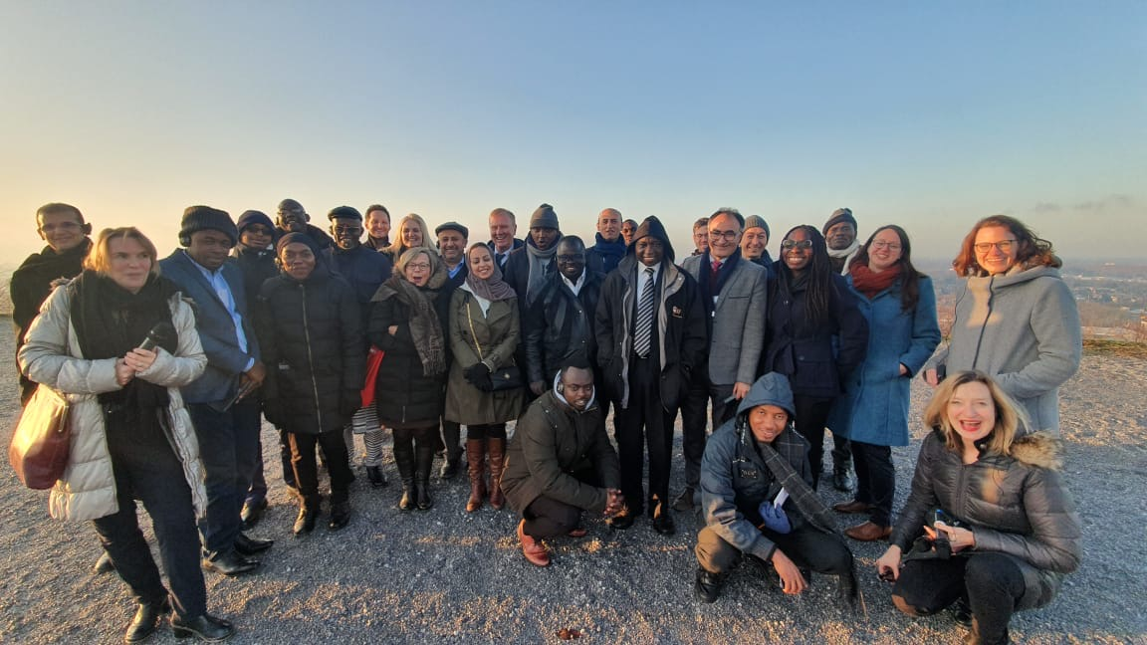
YouMatch - Global Initiative on Employment Services for Youth
Study Tour „Labour Market Information” 02 - 06 December 2019
North Rhine-Westphalia / Germany
CoP 1 “Labour Market Information” English / French
Facilitators: Katja Janischewski, Yasameen Al-Nadheri and Jean de Dieu Ndaruhuye

Slide 2
1. Guiding Questions for study tour meetings

Slide 3
Guiding Questions of CoP 1 EN/FR Members (1/3)
1. How to gain access to existing information?
1.1 How to put into value administrative data at LMI?
1.2 Clear identification of key valuables of different data sources?
2. How to link different data systems?
2.1 Which standard for data collection ?
3. How to ensure private sector participation in LMI?
4. How to link LMI to skills development & education policy?
5. How to build effective institutional set ups?
6. How to have sustainable HR structure?
7.Who are the LMI drivers?
8. Who are the main steering actors in central authorities?
8.1 What are the options for government & steering mechanisms advantages/disadvantages?

Slide 4
Guiding Questions of CoP 1 EN/FR Members (2/3)
9. Which role can CSOs/NGOs play at local level for LMI, mainly for tackling unemployment (data collection)?
10. How to design attractive target group specific products?
11. How to collect information at company level?
12. How to ensure capacity development for LMI analysis?
13. How to ensure data protection/security?
14. How to ensure high level policies support?
15. How to explore big data for LMI?

Slide 5
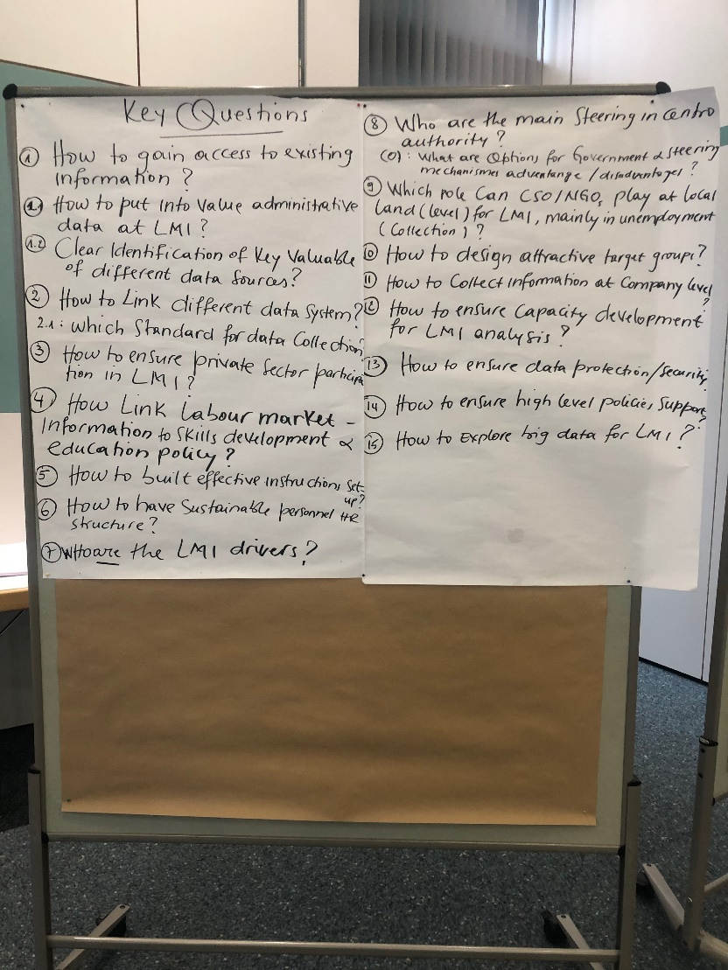
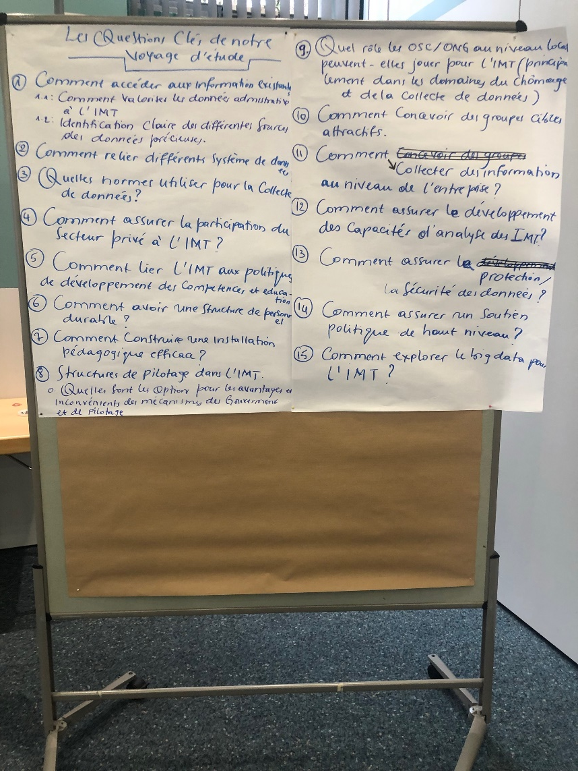
Guiding Questions of CoP 1 EN/FR Members (3/3)

Slide 6
2. Summary of study tour meetings

Slide 7
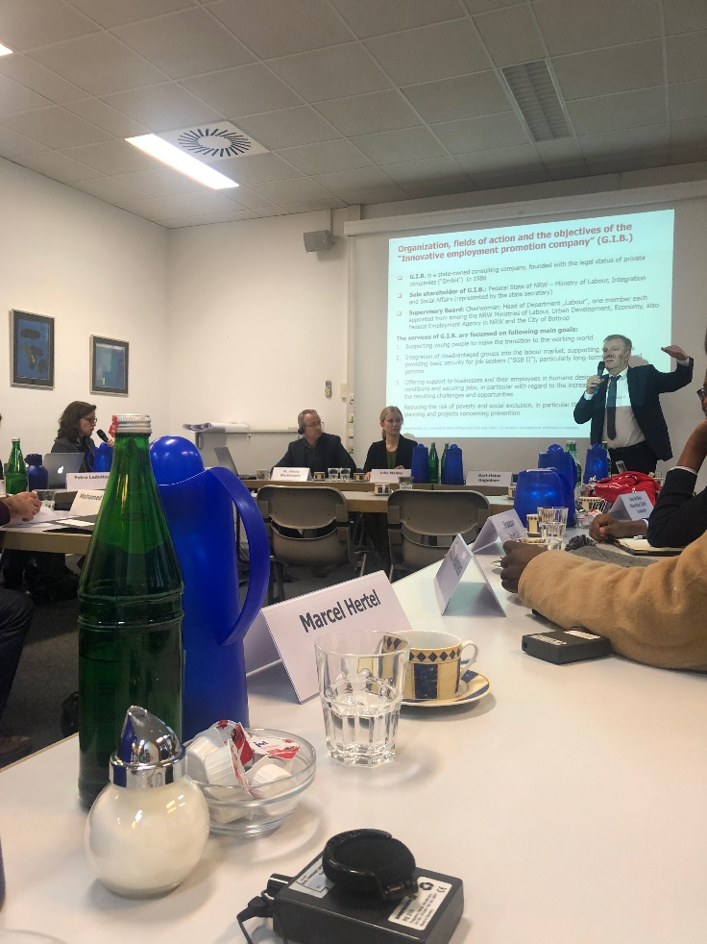
2.1 GIB - Gesellschaft für innovative Beschäftigungsförderung NRW / Association for Innovative Employment Promotion North Rhine- Westphalia
https://www.gib.nrw.de/
By: Gilbert Agaba & Albius Mwiya

Slide 8
Introduction:
Mr. Karl-Heinz Hagedorn, the Managing Director gave a presentation.
In his presentation he explained the economic situation of the region. He highlighted that the unemployment rate stood at 6.4 percent.
He also explained that their organisation’s main source of data is the Federal Employment Agency and the Federal Statistics Office.
He further stated that sometimes they collect their own data, because they are not a government department, they enjoy the autonomy. They have a good data base where they store information about their region and other regions in order to compare how they fare with other regions.
We have learned that they have around 30 labour market programmes; one of them is the “No graduation without continuation” where they assist young people who graduate secondary education to continue with either university or vocational training.

Slide 9
Main Employment Interventions:
Support disabled people to acquire employability skills and employment
Support businesses (companies) to get skilled workers
Fight poverty and social exclusion
Carry out M&E of employment programs in the region
Collect and analyze data on labour market
M&E Department
Main indicators:
Demography
Labour force
Income
The data collected are later disseminated through various platforms, as for comparison purposes, data collected and produced are desegregated at a Municipality level which helps to compare within the federal State. Also data are used to compare the NRW with rest of Federal States in Germany and rest of EU.
The Agency publishes annual reports and published on GIB websites and short reports in 15 pages for bi-annual and large annual reports.

Slide 10
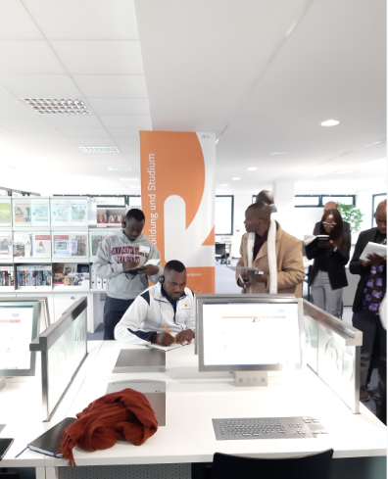
2.2 Employment Office Brühl https://www.arbeitsagentur.de/vor-ort/bruehl/startseite
By: Albius Mwiya

Slide 11
Vocational Information Centre (1st Session)
Information provided by Ms. Angela Schüller-Kistemann
It provides information to young people on study, financial support, vacancies on various occupations.
The centre is open to everybody including migrants.
No need to schedule an appointment
Free vocational counselling and career guidance.

Slide 12
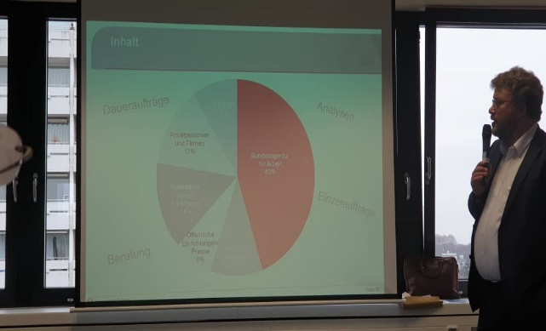
Federal Employment Agency – Statistical Service (2nd Session) – 1/3
Information provided by Mr. Jean-Claude Schenck:
Presentation on the labour Market Information system in Germany.
Various levels of information production such as European Level, National Level, Federal level and Local level.
Federal Statistics Office as important source of information, plus most relevant: full census based on own data sources
Information on social benefits for children and unemployed are also considered
Data on unemployment rate are needed by different industries.
Vocational counsellors advise prospective employees to look for occupations with opportunities

Slide 13
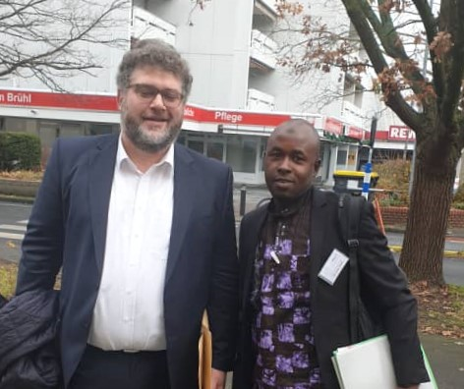
Federal Employment Agency – Statistical Service (2nd Session) – 2/3
Structure of Federal Employment Agency at three levels:
Headquarters in Nuremberg
10 regional offices
156 employment and employment agencies 602 agencies (SGB III)
303 employment center (shared Institutions, SGB II)
Special departments.

Slide 14
Federal Employment Agency – Statistical Service (2nd Session) – 3/3
Important for the credibility of statistics principles:
Professional independence
Mandate for data collection and access
Adequate resources
Commitment to quality
Statistical confidentiality and data protection
Impartiality and objectivity
Solid methodology
Appropriate statistical procedures
Avoid undue burden on respondents
Economy
Relevance
Precision and reliability
News and punctuality
Consistency and comparability
Accessibility and clarity
Why do we do statistics?
European regulations
Federal Statistics Law
Social code books
Statistical laws
Code of conduct for
European statistical statistics

Slide 15
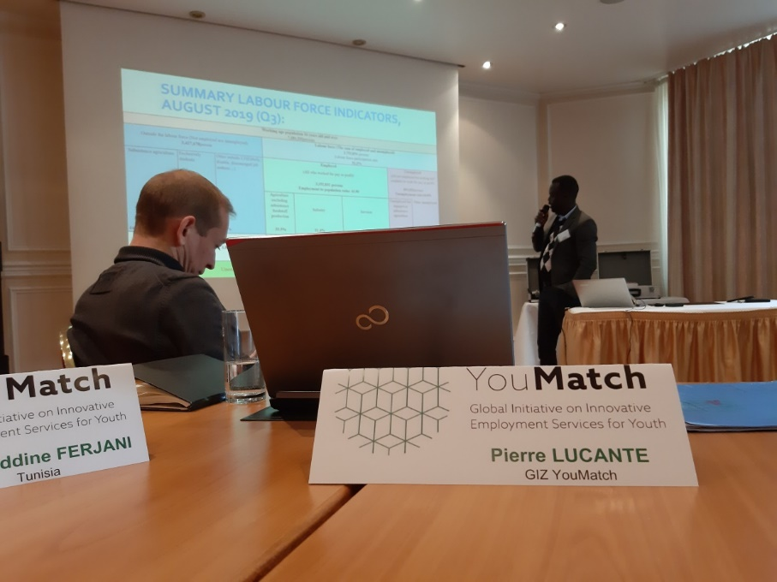
2.3 Case Study – Labour market information in Rwanda (1/4)
CoP (1) Members from Rawanda have presented the structure of their Labour Market Information System and the objectives of their LMIS such as identification of data gaps on the labour market, provide guidance to policy makers, students and employers and to forecast labour demand.
They have also explained that their main source of information is labour force surveys which is now conducted quarterly.
What was more interesting was that they also conduct sectoral skills audits and employment sectoral researches.
It was a lively exchange of ideas on the Rwanda case.

Slide 16
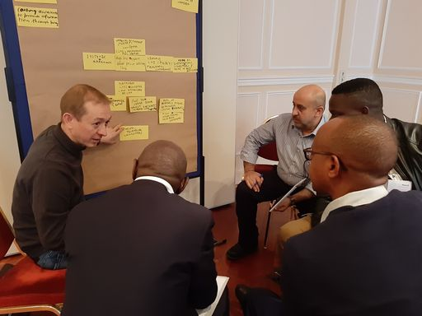
2.3 Case Study – Labour market information in Rwanda (2/4)
LMI objectives:
Identify missing labor market information and data
Work with different stakeholders to ensure the collection and availability of LMI
LMI Analysis in Rwanda
Provide advice to different stakeholders to make evidence-based on labour market decisions:
Policy Markers
Educaters and students
Employers and investors
Forecasting labor supply and demand for human resource planning

Slide 17
2.3 Case Study – Labour market information in Rwanda (3/4)
Main Labour Market Indicators:
Labor force indicator
Skills development indicators
Job creation indicators
Business development indicators for the formal sector
Employment indicators
Unemployment and underutilization of the workforce

Slide 18
2.3 Case Study – Labour market information in Rwanda (4/4)
Main data source:
RDB: Job portal and skills database
Surveys (skills deficit, job creation, employment intensity study, ...)
Secondary data source:
NISR
ORG/RDB
RSSB
WDA
RRA
ILO Website
Universities
Ministry of Education

Slide 19
2.4 BIBB- Federal Institute for Vocational Education and Training (1/3)
Informative presentation by Mr. Robert Koch, the senior policy Advisor of the Federal Institute for Vocational Education and Training.
His presentation was on the analysis of the information linking the labour market and the vocational education and training.
He explained that his organisation is central part of the Germany dual system in terms of the VET Act of 1969 and it is structured in accordance with Act 2005 as amended.
He further said that it is a legal obligation for BIBB to collect and publish data and reports that includes students trained yearly and he said they are funded by the Ministry of Education.

Slide 20
2.4 BIBB- Federal Institute for Vocational Education and Training (2/3)
Report on Vocational Training
In 2007: "The main committee of the Federal Institute for Professional Training (BIBB) recommends that “the federal government must reform and restructure the vocational training report as a whole."
"There should be a clear separation between a political part, that of the federal government, and a non-political part, which the Federal Institute of Professional Training shall be responsible for."

Slide 21
2.4 BIBB- Federal Institute for Vocational Education and Training (3/3)
Quality assurance takes place at different levels:
Drafting group: heads of institutes and departments, members of editorial teams, publishing, 2 members of BMBF
2 joint editorial meetings each year, 1 internal BIBB meeting (chapter meeting, advice on structure and future direction)
Contributions are made through the official channels (workspace management, responsible Chapter) and submitted.
The votes of the editorial groups are discussed with the employees.
Short-term changes to the structure of the structure can be discussed. The planning cycle can be discussed.
The BIBB constantly exchanges information with the BMBF.
The subjects and their presentation are discussed in the areas of work and project teams, and modified if necessary.
BIBB employees can submit their own subject suggestions (bottom to top).
If the results of BIBB research projects are included: the scientific advisory board and other advisory boards of quality assurance projects are involved.
Messages are marked with their names; which allows direct queries and professional exchange with the authors.

Slide 22
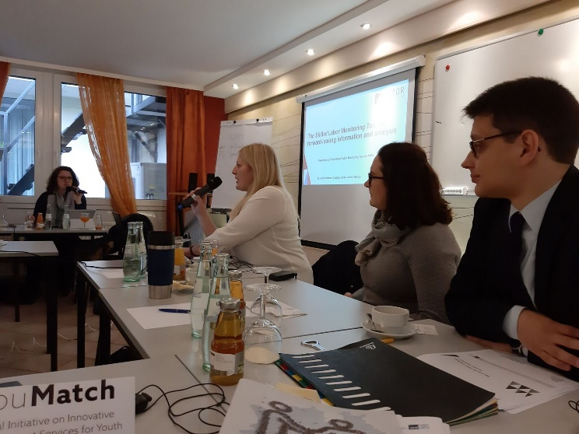
2.5 Regional Chamber of Commerce and Industry North Rhine-Westphalia / Research Institute WifOR (1/3) http://www.ihk-fachkraefte-nrw.de/
Mr. Andre Habrock, from Regional Chamber of Commerce and Industry North Rhine-Westphalia and Dr. Sandra Hofmann, from WifOR have presented their findings and the tools they use to forecast the supply and demand of the labour force in different economic sectors and occupations.
The presentation was done jointly by the Research Institute WifOR and the Regional Chamber of Commerce and Industry.
The employers explained that this information helps them plan proper in order to fill their vacancies. They have piloted this tool in 9 federal states in Germany and 3 in Austria. They explained that they get their data from the federal employment offices and from the chamber.
There is strong collaboration among stakeholders within the labour market.

Slide 23
2.5 Regional Chamber of Commerce and Industry North Rhine-Westphalia / Research Institute WifOR (2/3)
Analysis for the national labor market:
Professions and qualifications:
What is the specific situation of skilled workers in different university and professional positions?
Industries
How are the supply and demand for skilled workers and individual occupational groups changing overall?
Region
What is the situation of skilled labor in a particular region?
Intuitive web application
Labor supply with socio-economic characteristics
Comparison of supply and potential demand
Representation of skilled workers
Classification of occupational groups and industries
Detailed display of the map

Slide 24
What data and assumptions are hidden behind?
2.5 Regional Chamber of Commerce and Industry North Rhine-Westphalia / Research Institute WifOR (3/3)
Modeling the supply of skilled workers:
Employment statistics from the Federal Employment Agency
Unemployment statistics from the Federal Employment Agency
Demographic projection of the Federal Statistical Office
Forecast of the number of students from the Ministry of Education
Number of trainees from national statistical offices
Modeling the demand for skilled workers:
Economic indicators of the Chamber of Commerce:
Current commercial situation
Future business situation
Future number of employees
Commercial risk of shortage of skilled workers
Vacant jobs
Long-term trend:
Gross added value
Employed persons

Slide 25
2.6 Case Study – Labour market information in Morocco (1/2)
ANAPEC missions according to the law:
Labor Market Information
Prospecting, collecting job offers, and matching supply and demand
Reception, information and orientation of job seekers
Advice to employers in defining their skills needs

Slide 26
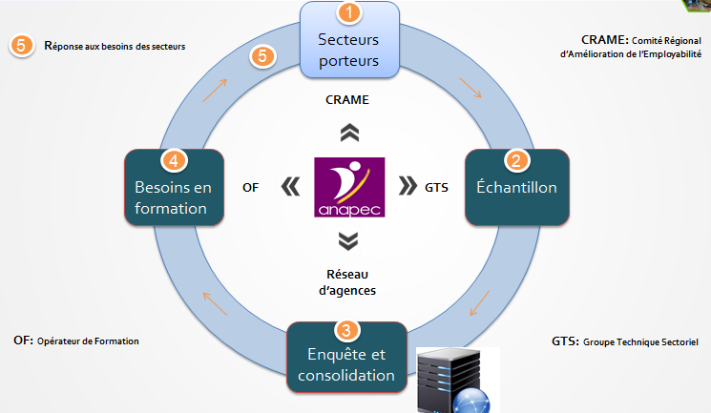
2.6 Case Study – Labour market information in Morocco (2/2)
1. Employer needs
Professional skills
Personal skills
Profitability / Efficiency
2. Need of the training organization
Labor market information
Profitability
3. Need of the job seeker
A job
Information and vocational guidance
Support measures (advice, training, networking)
4. Role of ANAPEC
Meeting point
Listening, analysis, response
Alternatives and solutions for its customers
Anticipation

Slide 27
3. Core insights from study tour meetings

Slide 28
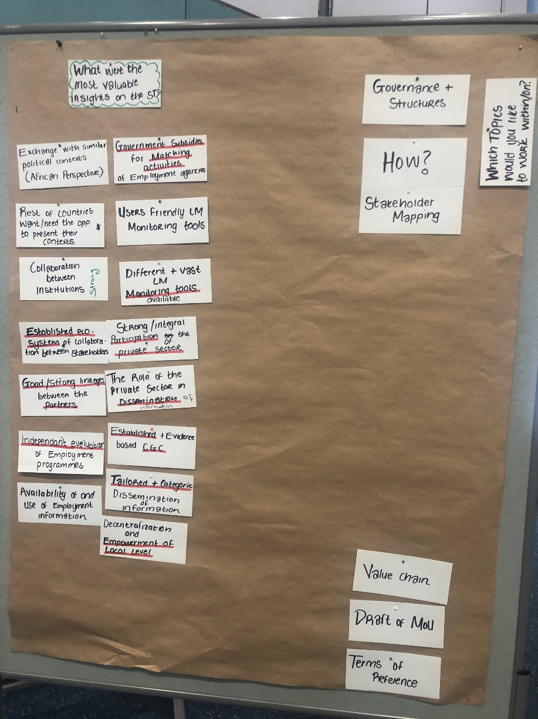
Most valuable insights of the Study Tour (1/2)
Relevance of exchange with similar political context (African Respective)
Benefits of strong/integral participation of the private sector in data collection and dissemination
Importance of collaboration between Institutions involved in LMI collection / dissemination
Approaches for independent evaluation of employment programmes
Availability and use of employment information

Slide 29
What were the most valuable insights on the Study Tour (2/2)
Importance of government subsidies for matching activities of employment agencies
Availability of user-friendly LM monitoring tools
Tailored and structured dissemination of information
Decentralization and empowerment of local level
Other participating countries’ representatives within CoPs want/need opportunities to present their context

Slide 30
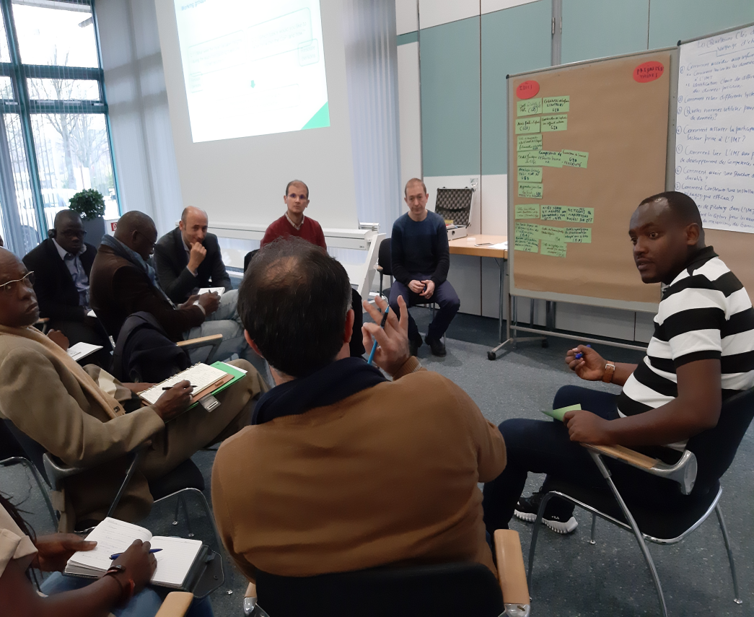
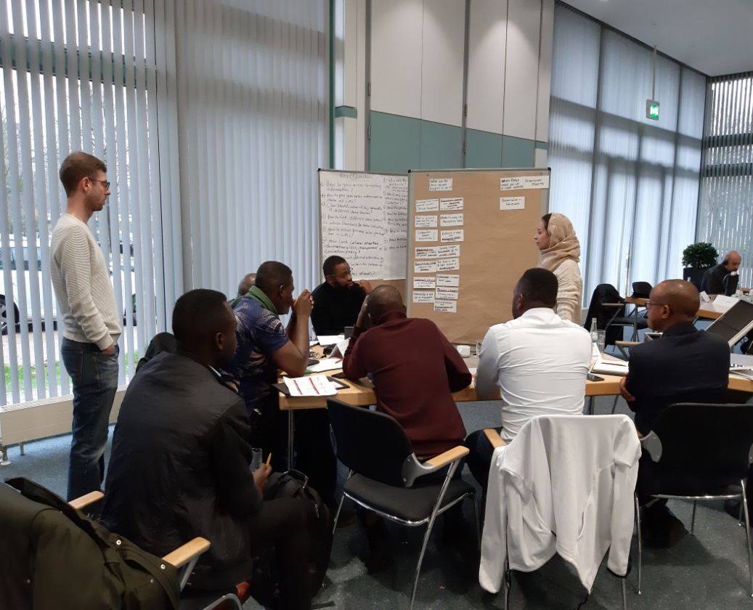
4. Way Forward

Slide 31
Way forward – Further work within CoPs EN/FR (1/3)
After joint reflection and voting of present CoP members, it was decided to focus on the topic of “LMI Governance” as a priority for January 2020 - May 2021
How?
A concrete approach will be suggested by a core team (Pierre, Honoré, Yasameen and Jado) and further discussed within the two CoPs

Slide 32
Way forward – Further work within CoPs EN/FR (2/3)
Further ideas on potential work topics:
Best legal mechanisms for observing data reporting
Legislative framework (obligations) of formalization of companies in matters of reporting information
Mapping of devices monitoring the labor market.
Private sector engagement in the information system.
User / product dialogue and coordination.
Support the interconnections of the information system.

Slide 33
Way forward – Further work within CoPs EN/FR (3/3)
Further ideas on potential work topics:
7. How other countries draft MoU
8. Learn how to standardize the LMI reports/indicators
9. How to write Terms of Reference

Slide 34
5. Evaluation

Slide 35
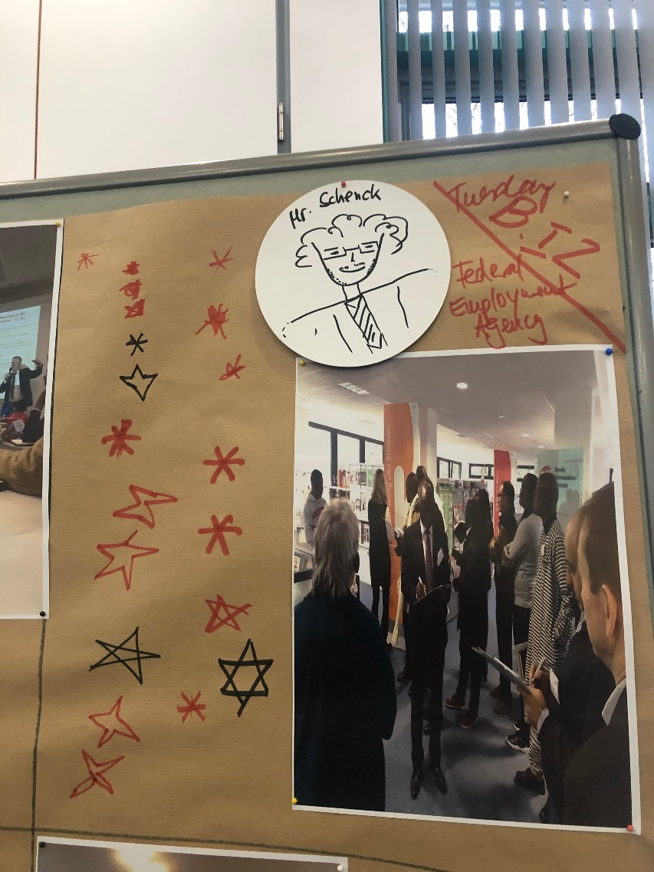
Evaluation 1 – Best rated meetings

Slide 36
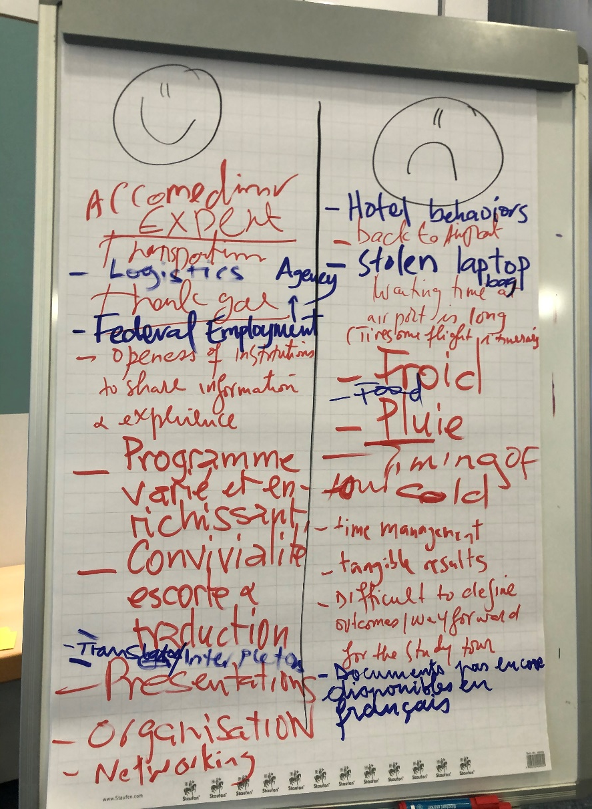
Evaluation 2 – Appreciation and room for improvement

