Slide 1
In cooperation with
Study Tour „Labour Market Information” 02 - 06 December 2019 North Rhine-Westphalia / Germany
Notes:
Hounorable Ministers,
Your Excellencies,
Ladies and Gentlemen.
All protocols highly observed.
The conference of the coming two days is all about giving young people perspectives.
YouMatch, which is a programme commissioned by the German Federal Ministry for Economic Cooperation and Development, contributes to that perspective by improving the link between labour demand and labour supply through regional exchange on employment services.

Slide 2
Study Tour Programme

Slide 3
Core topics
Roles and responsibilities of different actors at national and regional level for collection, analysis and dissemination of LMI
Variety of sources for LMI, including qualitative data and private sector
Engagement of private sector in LMI (for data collection, analysis and usage)
Usage of LMI in design and implementation of different labour market intervention and services (including career guidance)
User-friendly processing and visualisation of LMI
Addressing informal sector in LMI

Slide 4
Monday, 14:30 – 17:30
G.I.B. = Association for innovative employment promotion North Rhine-Westphalia; public-owned institution of the Federal State NRW to support employment promotion
Data from official statistics on the labor and training market as well as on employment and corporate development in NRW
Semi-annual LM Reports at various levels
Practice-oriented reports
Annual Report on transition school to work
Short Reports on selected topics
Link to Labour Market and Employment Policies and Measures (Labour Ministry NRW)

Slide 5
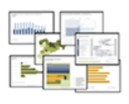
Tuesday, 10:00 – 14:00
Federal Employment Agency – Statistical Service
1 central Unit in Nürnberg, 5 Regional Offices
Offical statistics in Germany
Reference for policy advice / specific measures
FEA own statistics/data collection, analysis and disseminiation on LM at national and regional level
Employment Office Brühl
Variety of products / tools for different target groups

Slide 6
Wednesday, 10:00 – 12:00
Case Study – Labour Market Information in Ruanda

Slide 7
Reflection Workshop - Wednesday, 13:00 – 14:30
Technical working groups on priority subjects in line with identified needs and first findings

Slide 8
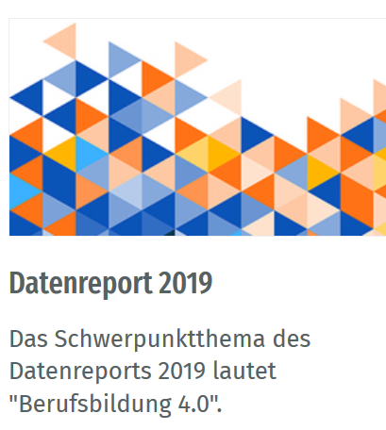
Wednesday, 15:00 – 16:30
Federal Institute for Vocational Education and Training
Annual Data Report supplementing the Report on Vocational Education and Training published by the Federal Ministry of Education and Research (BMBF) by providing a wealth of information and analysis relating to various aspects of the development of vocational education and training and linkage to LM

Slide 9
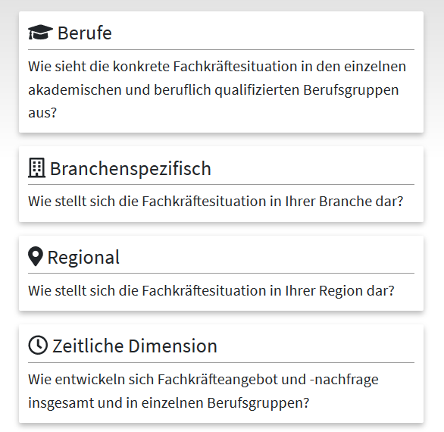
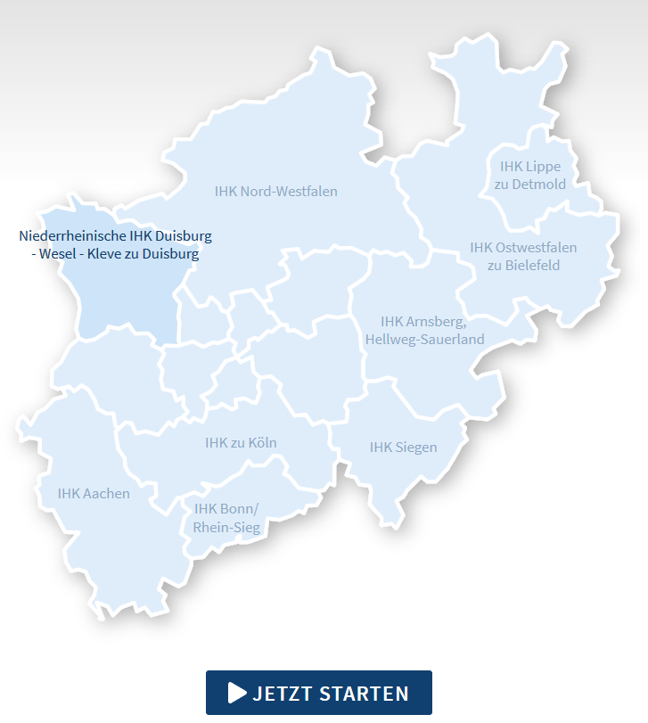
Thursday, 10:30 – 13:00
Instrument for analysis and forecasting of skilled labour demand and supply in North Rhine-Westphalia, its sub-regions as well as industries until 2030

Slide 10
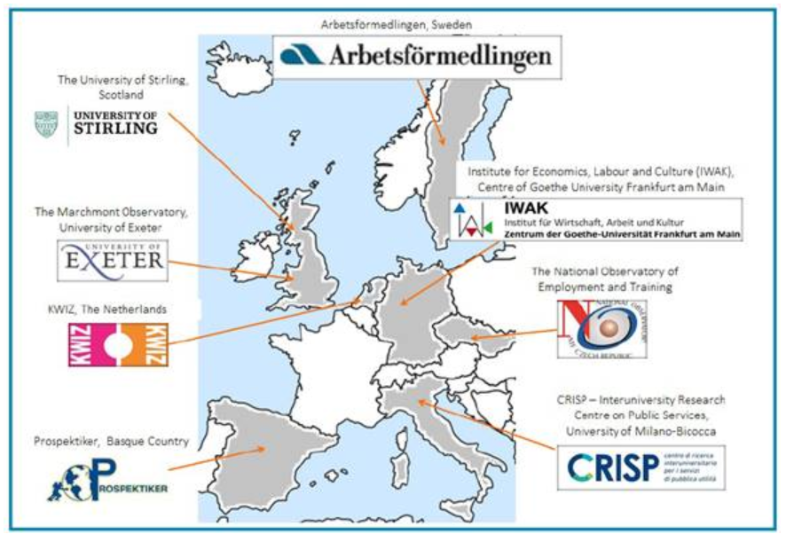
LM Intelligence Toolkit
Thursday, 14:00 – 15:30
Toolkit for policy makers and LMI practicioners, providing a range of tools and approaches on linking LMI and educational policies/measures

Slide 11
Closing Session - Friday, 10:00 – 13:00
Feedback and impressions on different meetings
Reflection on most valuable insights
Set-up a framework and priorities for further exchange within CoPs
Exchange with AU on framework requirements

Slide 12
Snapshot Federal State North Rhine-Westphalia

Slide 13
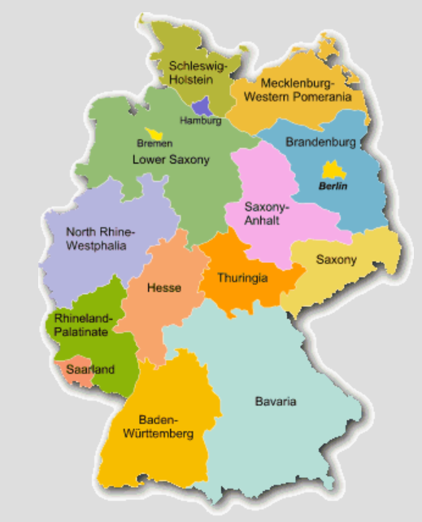
1 out of 16 Federal States
Constitutional principle of Germany
High sovereignty of Federal States, including in the field of education

Slide 14
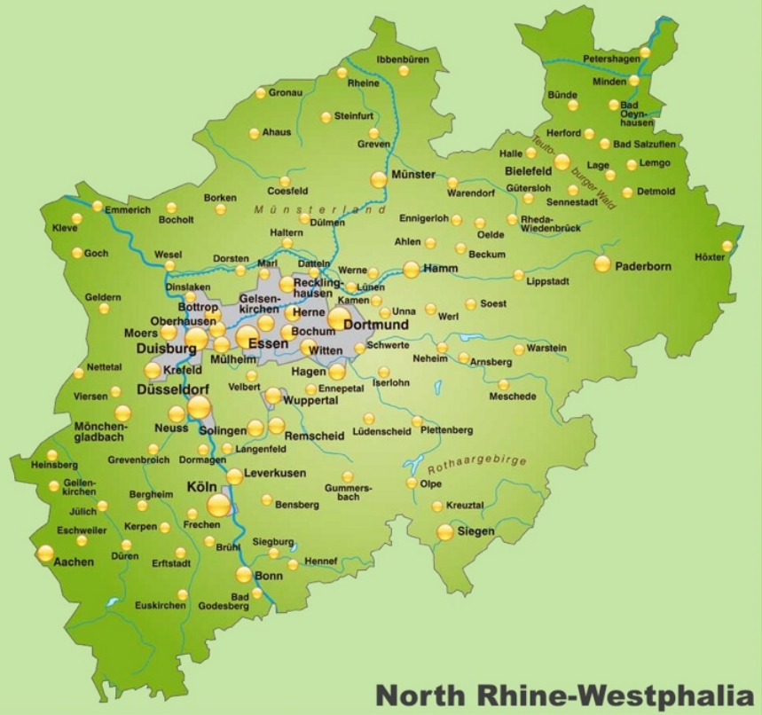
Population: 18 million (most densely populated territorial state)
30 out of 80 German cities with > 100,000 inhabitants
“Rhine-Ruhr Metropolitan Region”: Largest urban area in Germany, 3rd largest on European continent
5 government regions (“Regierungsbezirke”), divided into 31 districts (“Kreise”) and 23 urban districts (“kreisfreie Städte”)
State Capital: Düsseldorf, largest city: Cologne

Slide 15
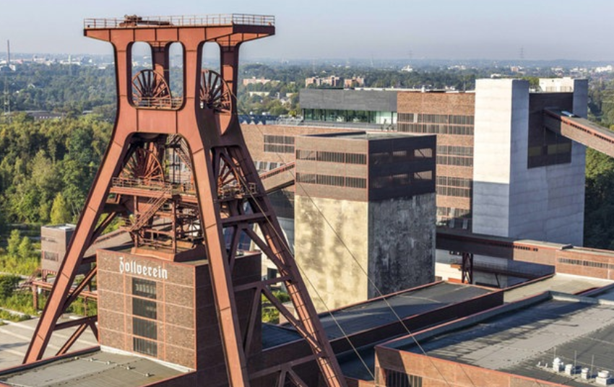
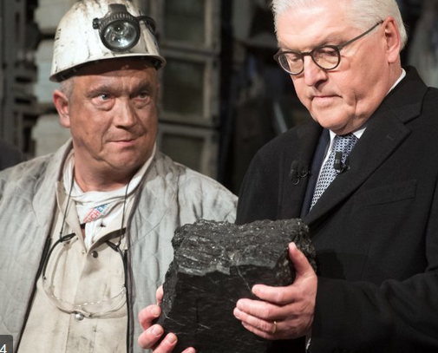
1950/60ies: “Land of Coal and Steel”, important part of German recovery after WW II
Major structural economic changes since then, but still considerable challenges in selected regions
Large share of SME (approx. 750,000), 18 of the 50 largest German companies (e.g. Bayer, ThyssenKrupp, Bertelsmann, Deutsche Post, Deutsche Telekom, E.ON, Henkel, RWE)
Approx. 73% of labour force employed in service sector, 25% in industry/construction and 2% in agriculture
Approx. 20% of German GDP

Slide 16
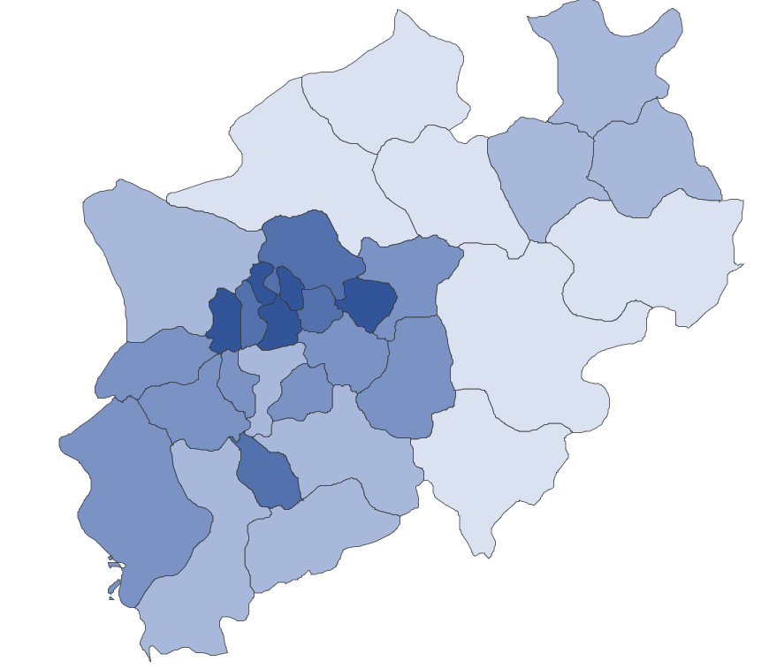
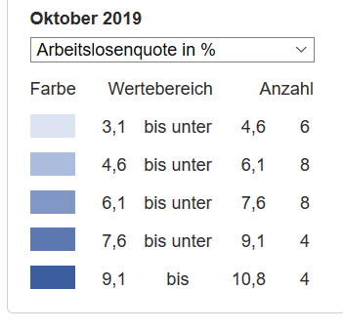
Unemployment rate NRW (October 2019): 6.4 % (Germany: 4.8%)

Slide 17
Needs assessment and guiding questions

Slide 18
Working groups for Introduction Session (EN/FR)
Q 1: „Which experiences have you already made within your countries on LMI?”
Q 2: „What are most relevant needs and challenges for effective labour market information in our countries?“
Resoure persons
Resoure persons
Reporting back to plenary (pin boards)
Plenary: Joint elaboration of Guiding Questions

Slide 19
Recap – Mindmaps of CoPs (FR)

Slide 20
Recap – Mindmaps of CoPs (EN)

Slide 21
Reflection Workshop (Wednesday)

Slide 22
Working groups for Reflection Workshop (EN/FR)
Brainstorming: „Based on the first meetings, and considering the guiding questions, which questions/topics would you like to further discuss with your peers and resource persons?”
Prioritisation and formation of working groups
Resoure persons
Resoure persons
Reporting back to plenary (pin boards)

Slide 23
Closing Session (Friday)

Slide 24
Closing Session - Friday, 10:00 – 13:00
Feedback and impressions on different meetings
Reflection on most valuable insights
Set-up a framework and priorities for further exchange within CoPs
Exchange with AU on framework requirements

Slide 25
Working groups for Closing Session (EN/FR)
Q 1: „What were the most valuable insights during the study tour?”
Q 2: „Which topics would you like to work on within the CoP?“
Resoure persons
Resoure persons
Reporting back to plenary (pin boards)
Joint elaboration of work programme for CoPs

